Slide 1
Project HEALINGS

Slide 2
Project HEALINGS
Combating Misinformation
Presented by: Ange Hwang
Executive Director
Asian Media Access

Slide 3
What is Project HEALINGS
Project HEALINGS of MN - Health Education and Adult Learning Incorporated with Navigating Government Systems
Project HEALINGS was created as a HUB for improved health and wellness among Minnesotans disenfranchised by identity and circumstance, facing disparities in both healthcare access and health outcomes, and impacted disproportionately by the COVID-19 pandemic.

Slide 4
Tasks
Monthly Collaborative Meeting;
Interviewing our partners for vaccination hesitancy and access barriers, led by HACER;
Town Hall Meeting collaborating with our partners, led by Diversity Council;
Educational Campaign collaborating with our partners, led by Asian Media Access; and
A lot of educational conference, events and vaccination pop up clinics, led by all of us – AND REPORTING

Slide 5
Lead Agency
Diversity Council
Executive Director - Dienna Sabol, dees@diversitycouncil.org
Program Director - Kathy Harowski, kathyh@diversitycouncil.org
Financial Staff - Stefanie Meunier <bookkeeper@diversitycouncil.org>

Slide 6
Co-Lead Agency
Asian Media Access
Executive Director – Ange Hwang, angehwang@amamedia.org
Director of Multimedia Technology – Steve Lu, stevelu@amamedia.org
Media Campaign (Website and Social Media Management) – Jiang Zhu, Jiang.zhu@amamedia.org

Slide 7
Co-Lead Agency
Hispanic Advocacy and Community Empowerment through Research (HACER )
Executive Director – Rodolfo Gutierrez, rodolfo@hacer-mn.org
Program Coordinator - Ruben Gonzalez, <ruben@hacer-mn.org>

Slide 8
What is out there ?
COVID-19 just like the common flu and Nature Immunity Preferred
Vaccine’s long term impacts
Misinformation about Vaccination, ex. altered the DNA, or impacting on fertility
Joking about Vaccination
Providing another research to indicate the unnecessary
Attacking the Vaccination Host
No matter what you said – It’s my RIGHT to not get vaccinated

Slide 9
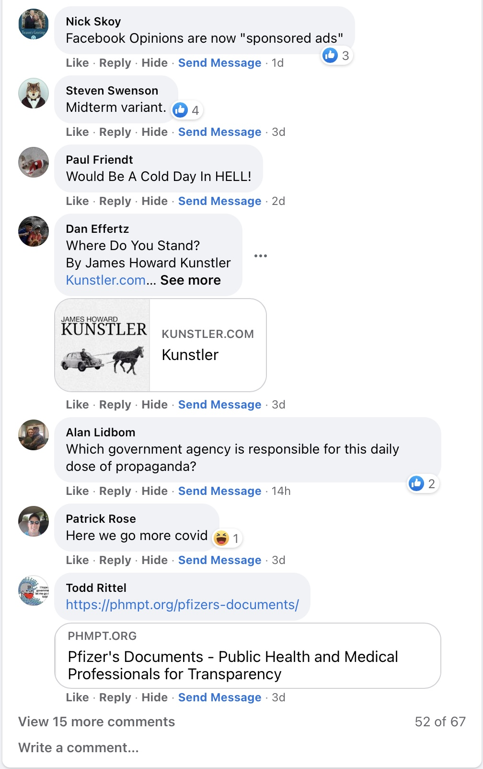
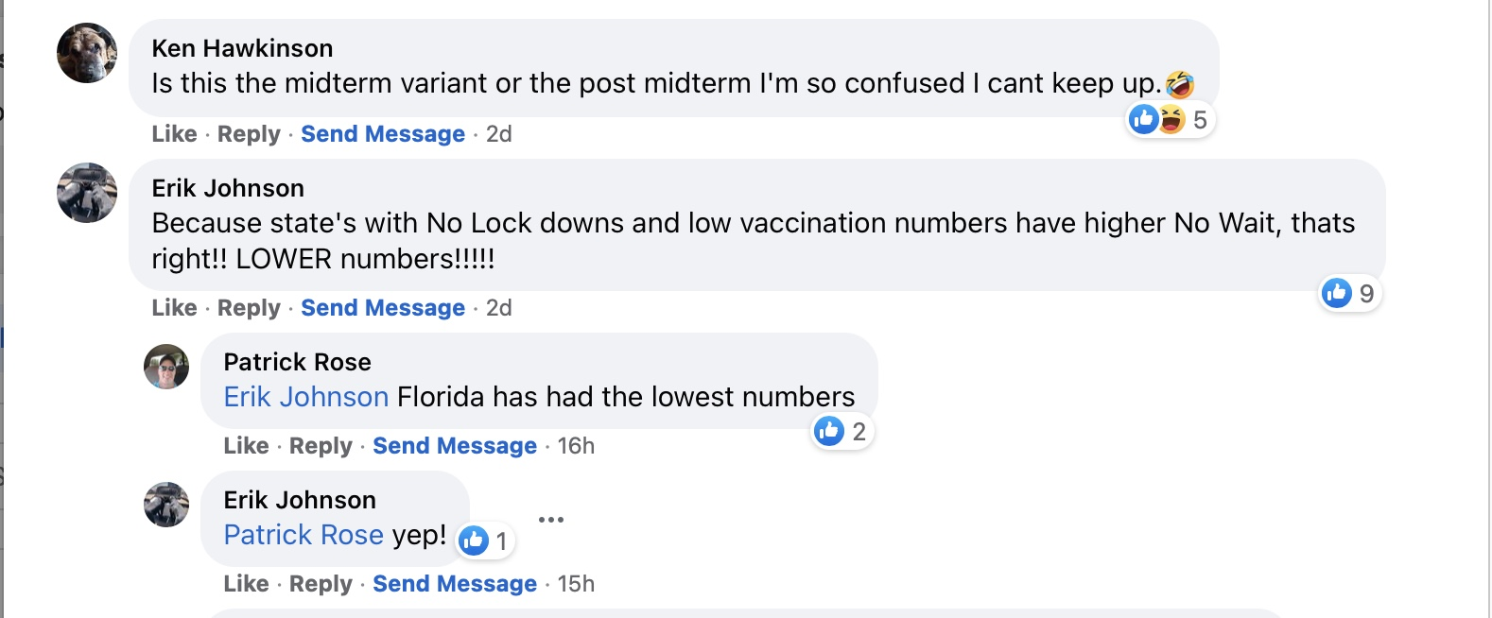
Gambling, Shopping, and Winning

Slide 10
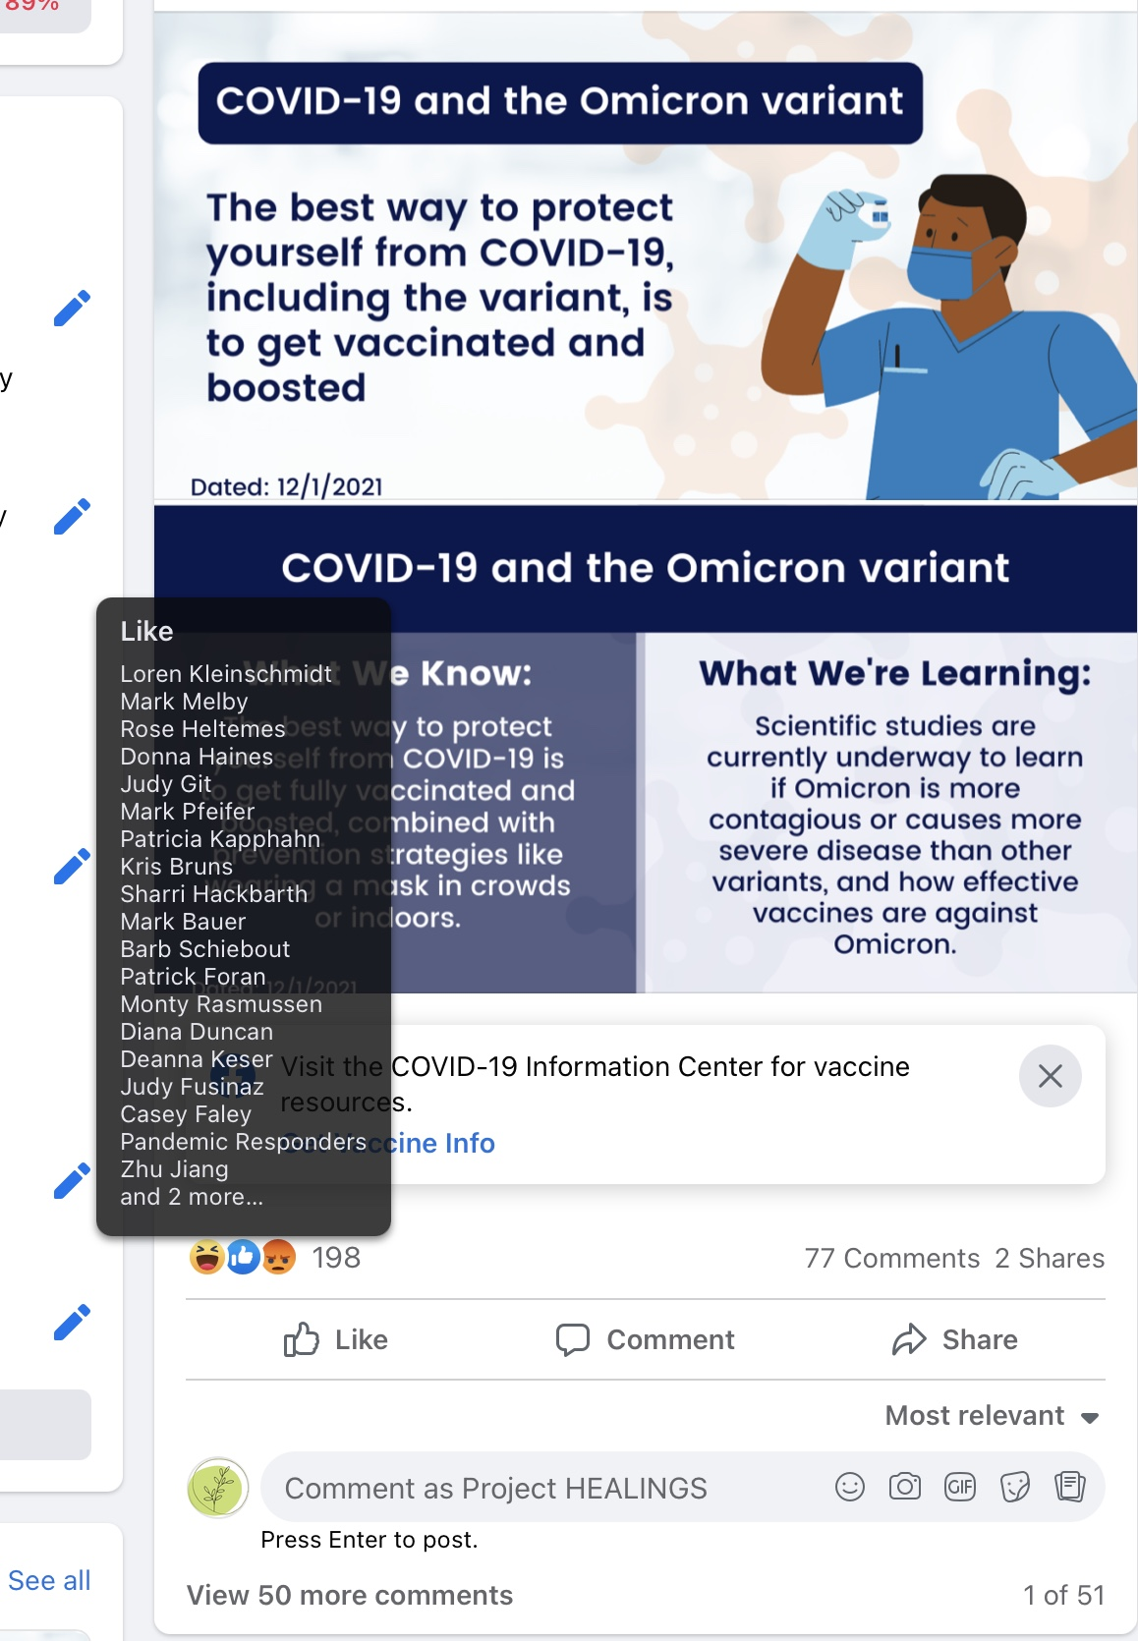
Gambling, Shopping, and Winning

Slide 11
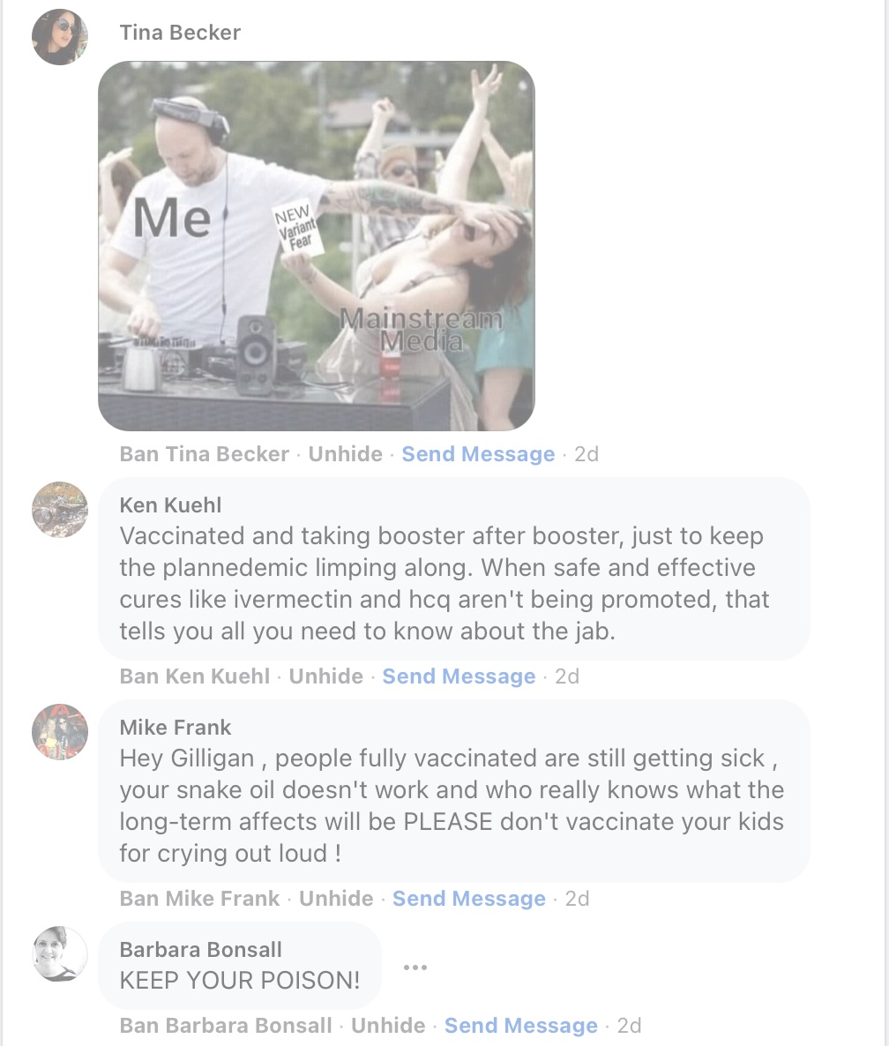
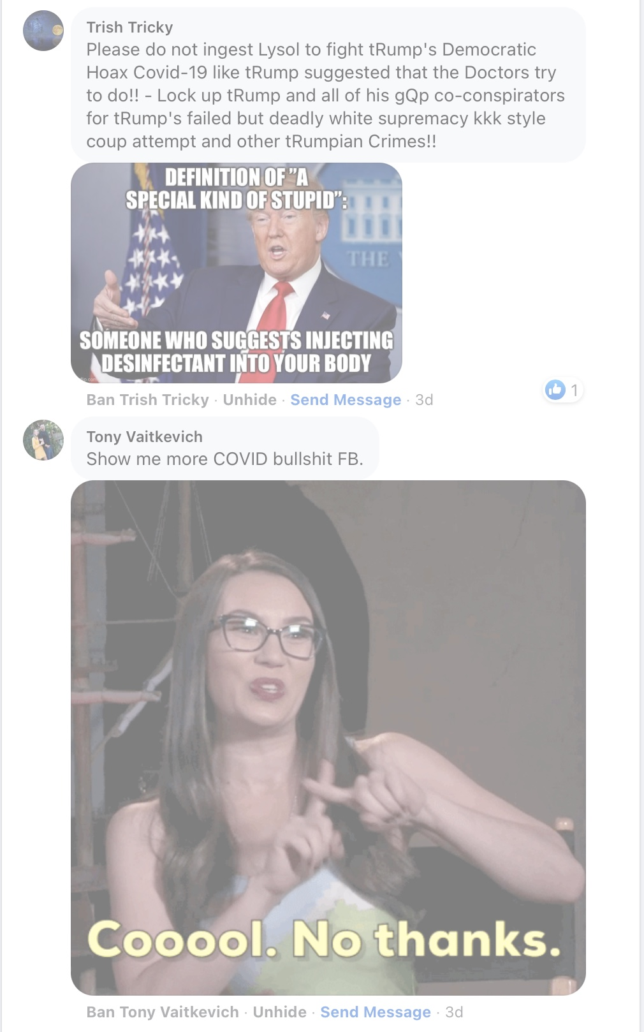
Gambling, Shopping, and Winning

Slide 12
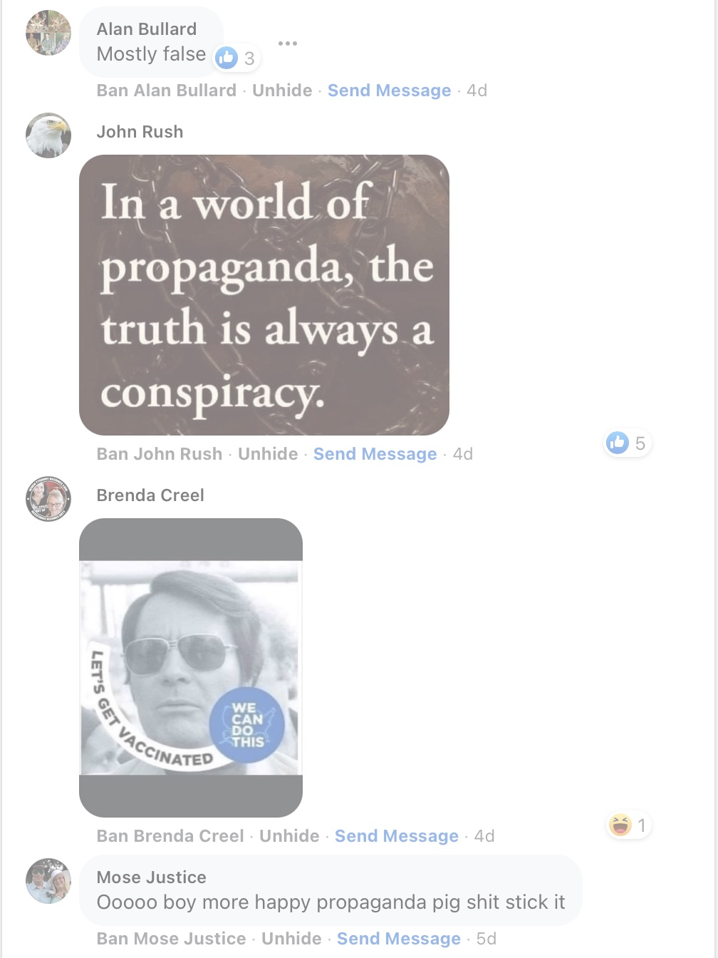
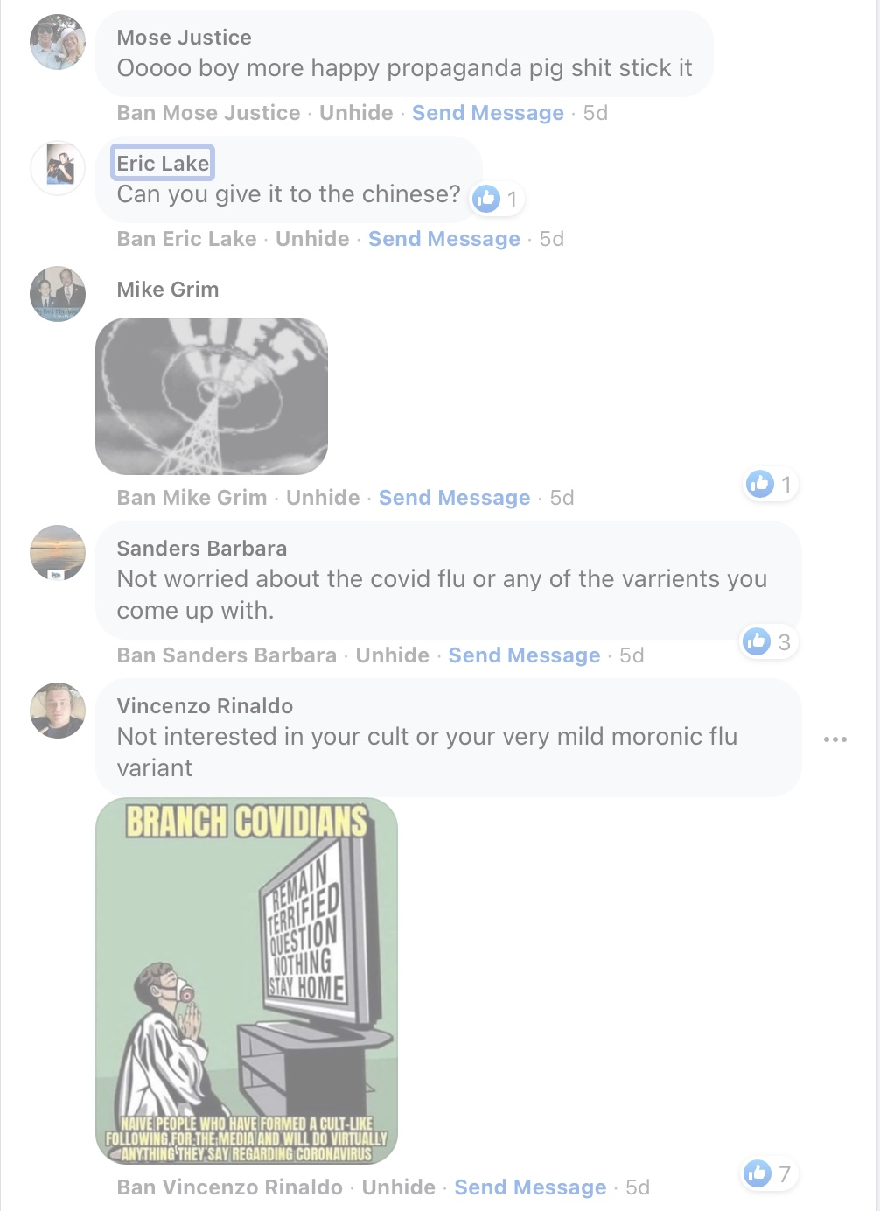
Gambling, Shopping, and Winning

Slide 13
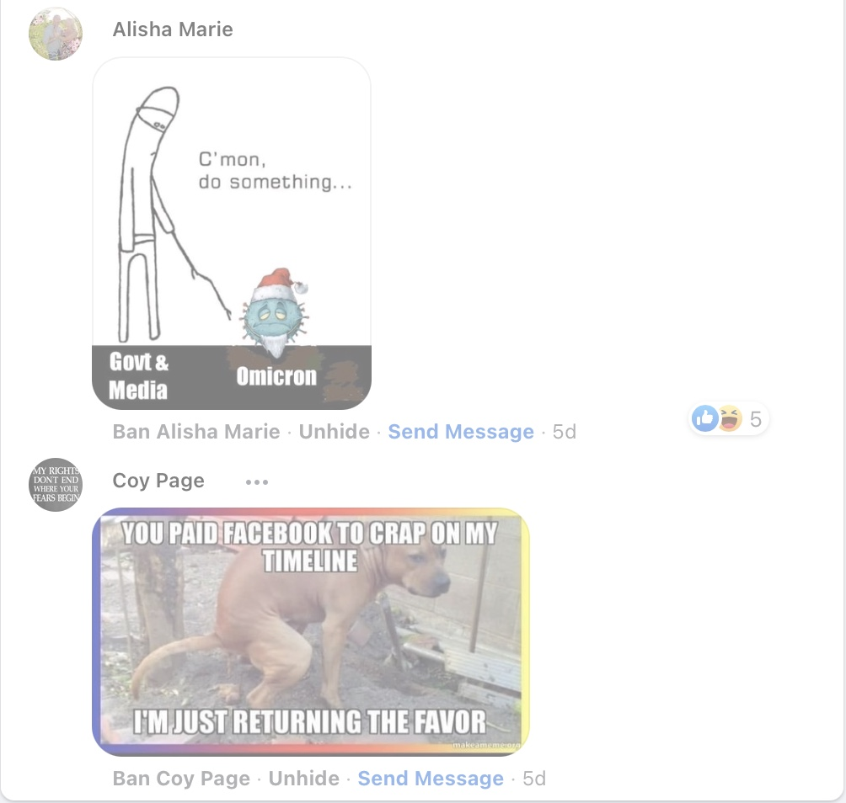
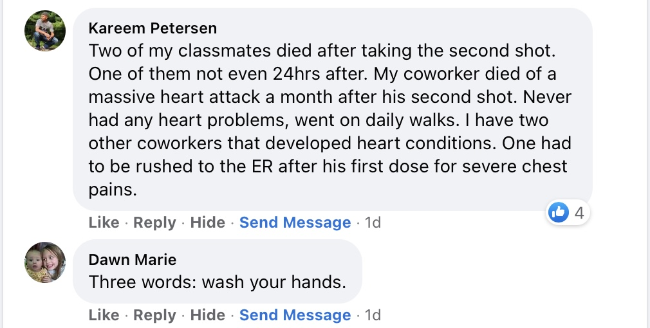
Gambling, Shopping, and Winning

Slide 14
What can we do?
Value Proposition #1 – Consideration – Thanks, but here is the FACT – provide correct information to replace the misinformation without arguments
Value Proposition #2: Diversion – Do you happen to know…. providing another historical fact
Value Proposition #3: Immersion – Providing Context and WE ARE IN THIS TOGETHER
Value Proposition #4: Progression - Emphasizing the Future – to better protect your family and children
Value Proposition #5: Repetition - Like a broken record – repeating your messages again and again – Make correct information more memorable

Slide 15
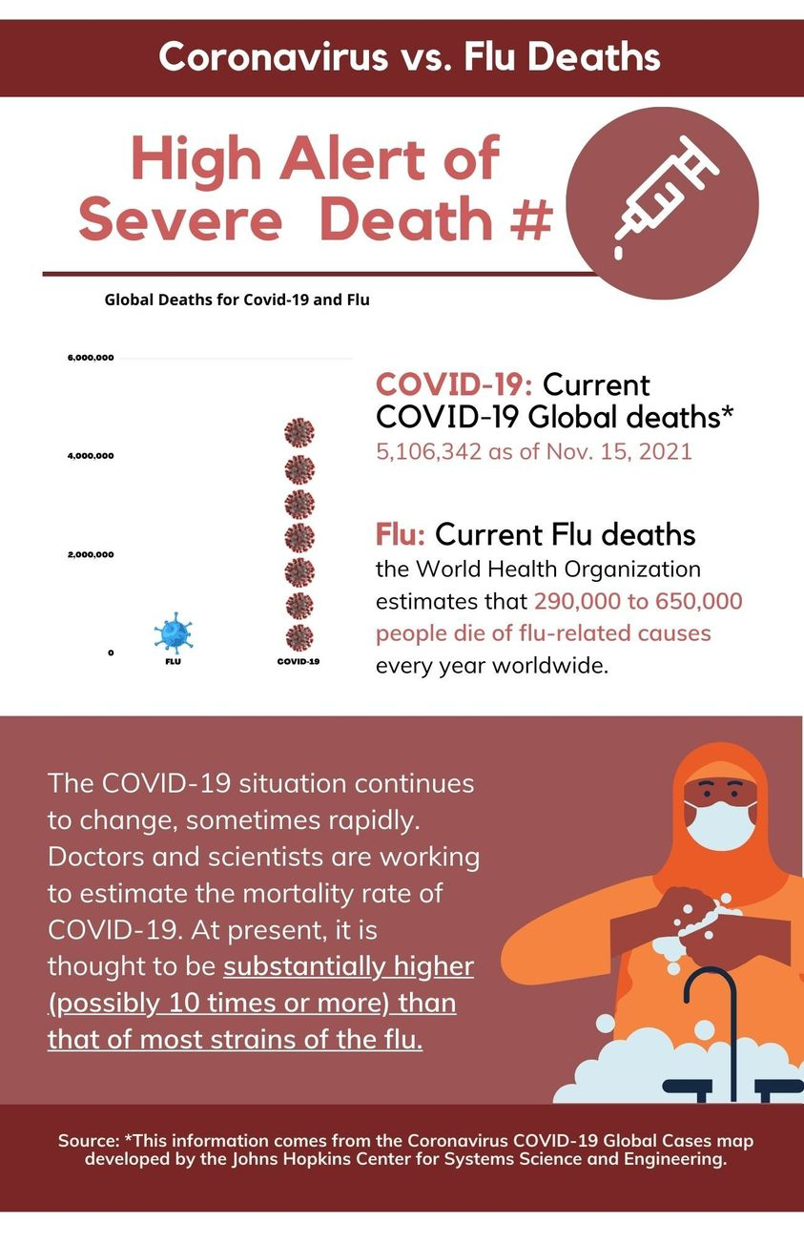
Value Proposition #1 – Consideration – Thanks, but here is the FACT – provide correct information to replace the misinformation without arguments
If you look at the U.S. stats compared to the rest of the world, it is obvious something is wrong here. We were the first to have mass availability of vaccines, yet 62.4M infected and over 841K dead. The most deadly contagious disease in our country's history. Many of those death were preventable with vaccination.

Slide 16
Value Proposition #2: Diversion – Do you happen to know…. providing another historical fact
The Majority of Americans already taking the vaccines, would you join us?
Go to a reputable medical information website like the CDC and World Health Organization and make a list of as many facts as you can find about COVID-19 and the vaccines.

Slide 17
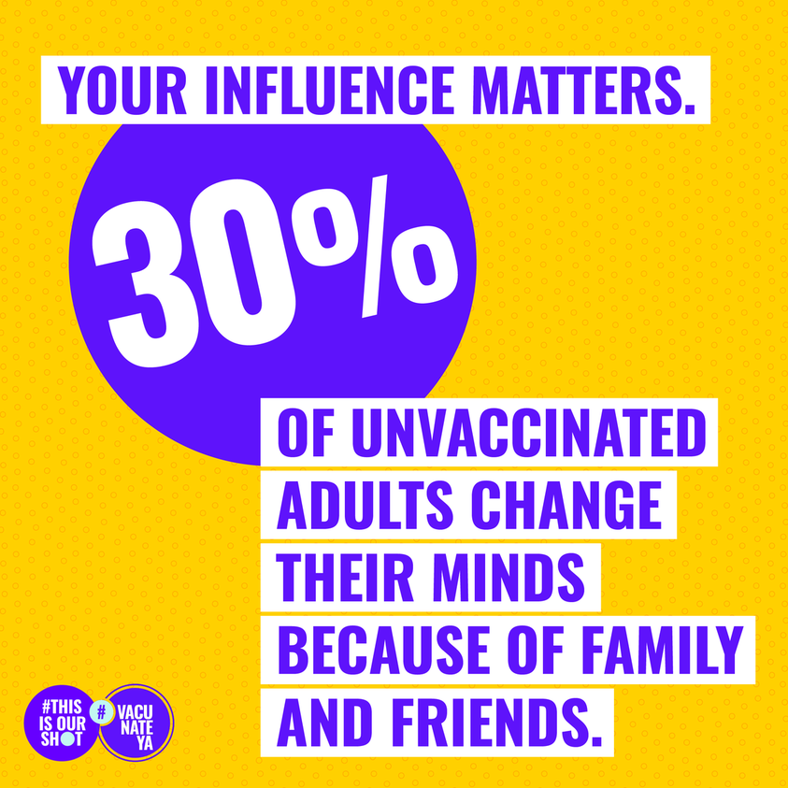
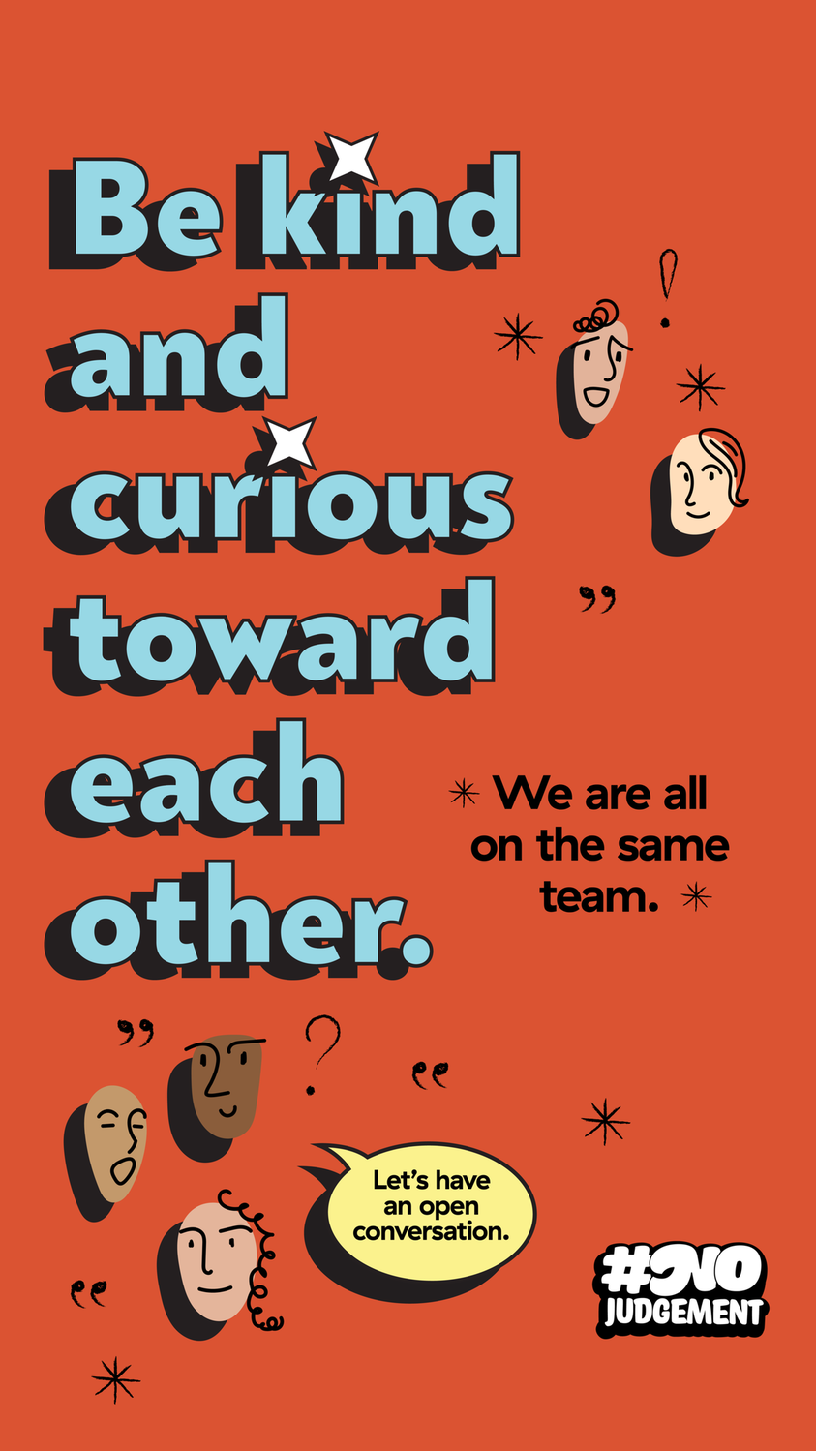
Value Proposition #3: Immersion – Providing Context and WE ARE IN THIS TOGETHER
You’d think that at some point, the anti-vaxxers would take a hint regarding the importance of vaccines and their collective role in human history.

Slide 18
Value Proposition #4: Progression - Emphasizing the Future – to better protect your family and children
We've spoken to many people in our community who have decided not to get vaccinated because they feel protected by natural infection after recovering from COVID. What do we know about their protection level against COVID vs. someone who has been vaccinated?
ANS: It is an understanding that natural immunity can protect people, but the speed in gaining herd natural immunity cannot compete with the speed of the current virus spreading. At this urgent stage, we can’t wait, we need everyone to get vaccinated, and VACCINE IS SAFE.

Slide 19
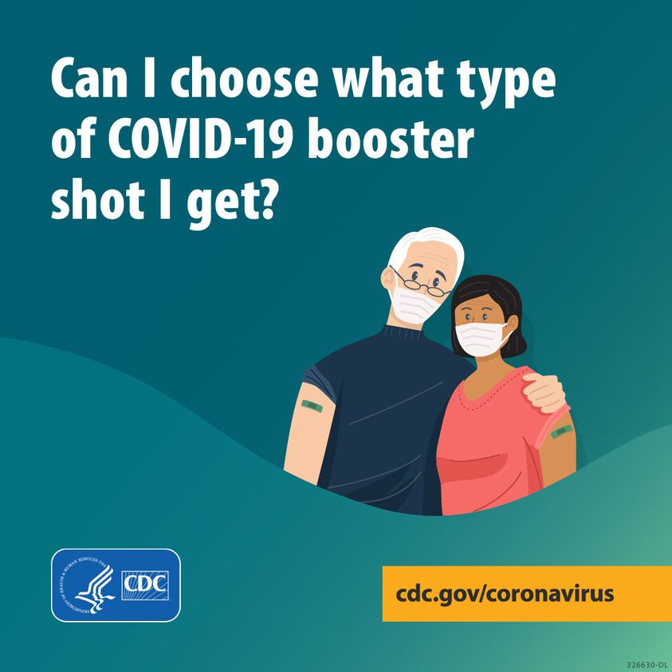
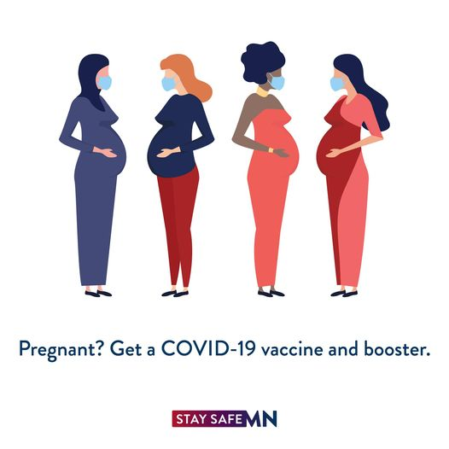
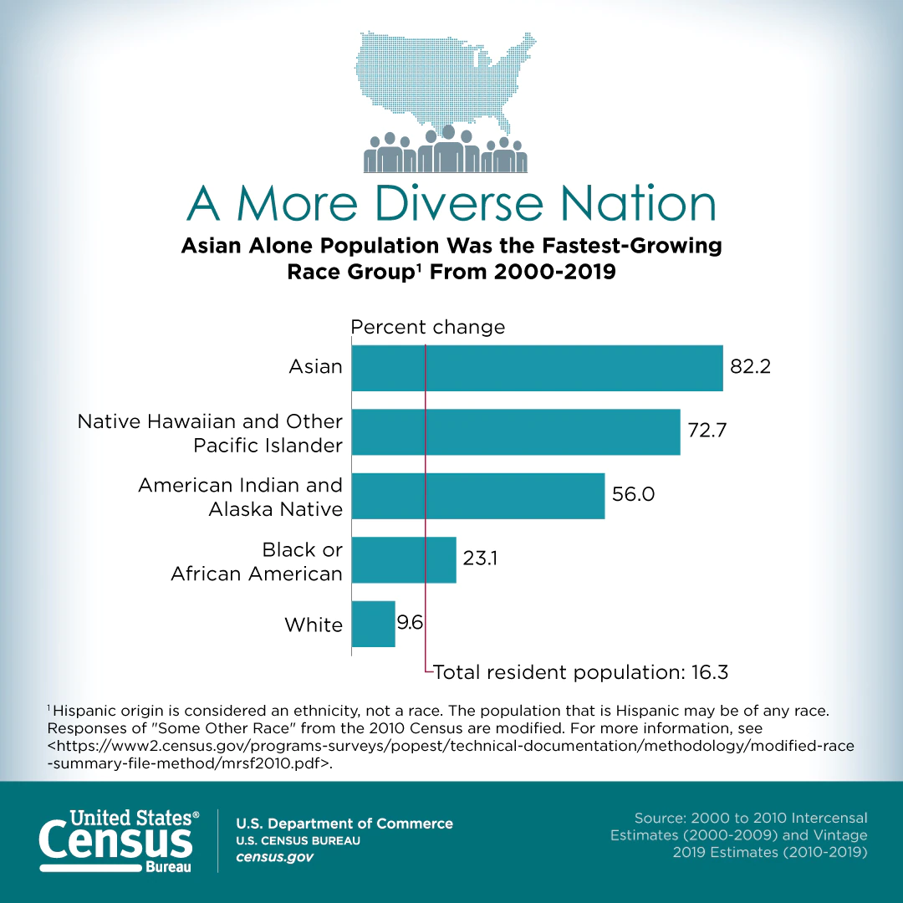
Value Proposition #5: Repetition - Like a broken record – repeating your messages again and again – Make correct information more memorable
Can anyone explain why COVID treats individuals differently? I work at a nursing home and take care of a lady over 100 years that had covid for a few weeks and didn't die from it, including most of the residents who had it and survived (a small amount died).
ANS: Because every person is unique in DNAs and physical features. That’s why every person shouldn’t gamble and every person needs a vaccine.

Slide 20
Gambling, Shopping, and Winning
Different than health-centered social media posts, check these sites for good examples:
https://www.themanufacturinginstitute.org/research/thisisourshot/
https://sites.google.com/ideo.org/nojudgment/home

Slide 21
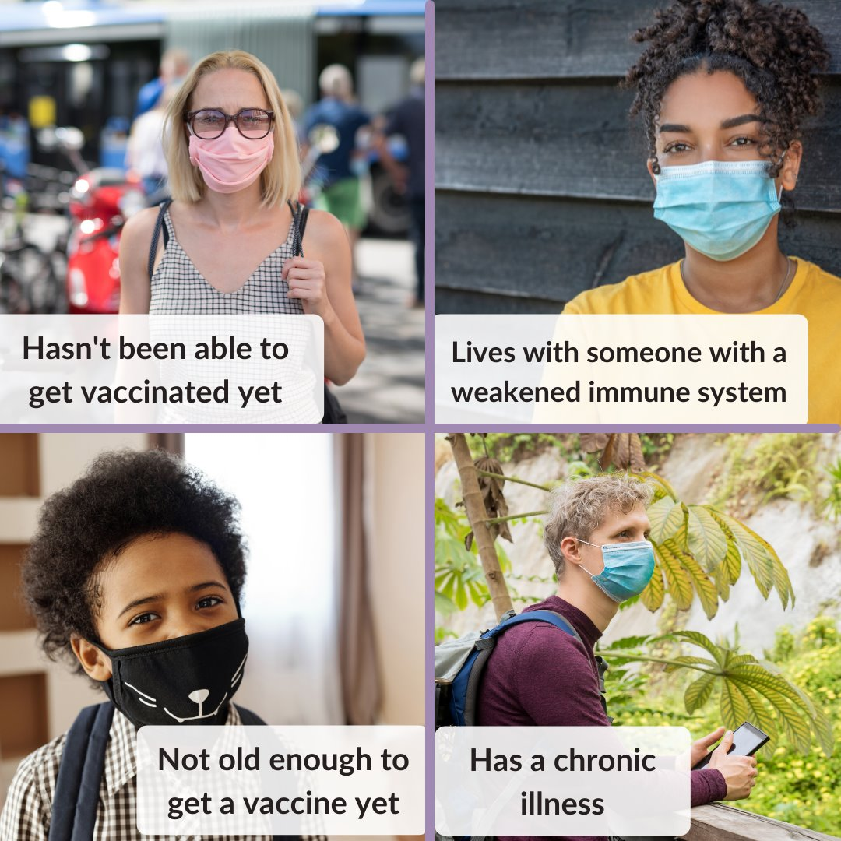
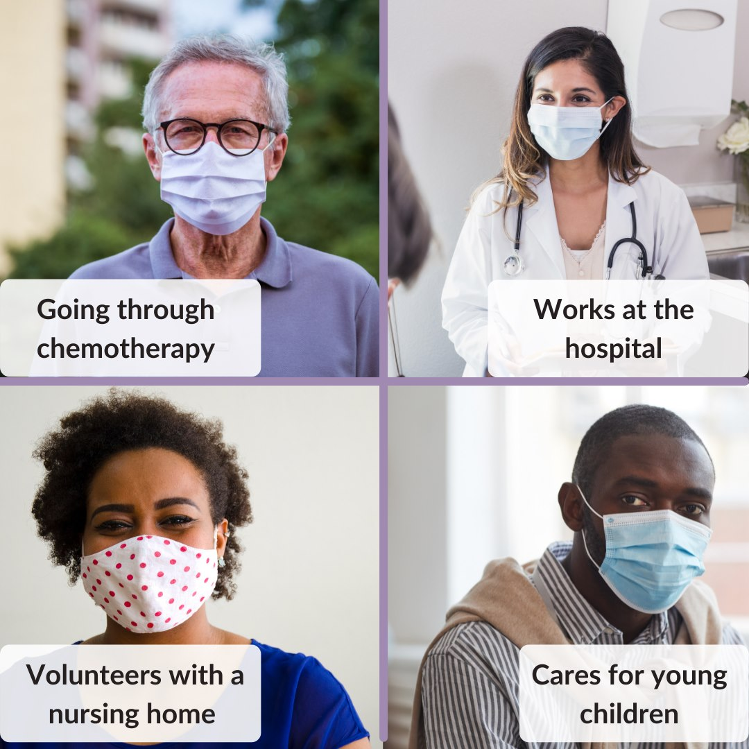
SIMPLE THINGS WE CAN DO

Slide 22
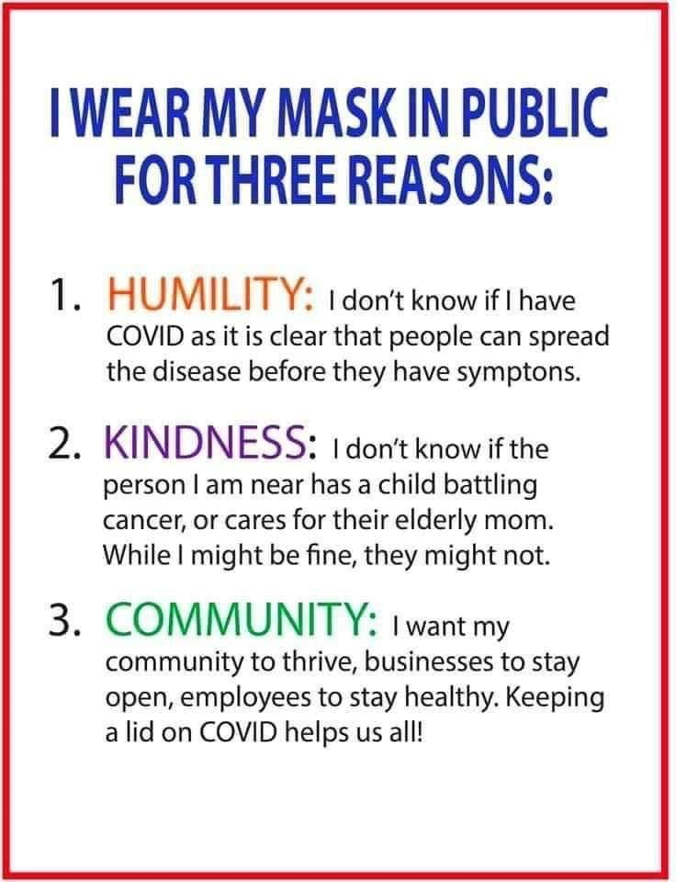
Gambling, Shopping, and Winning

Slide 23
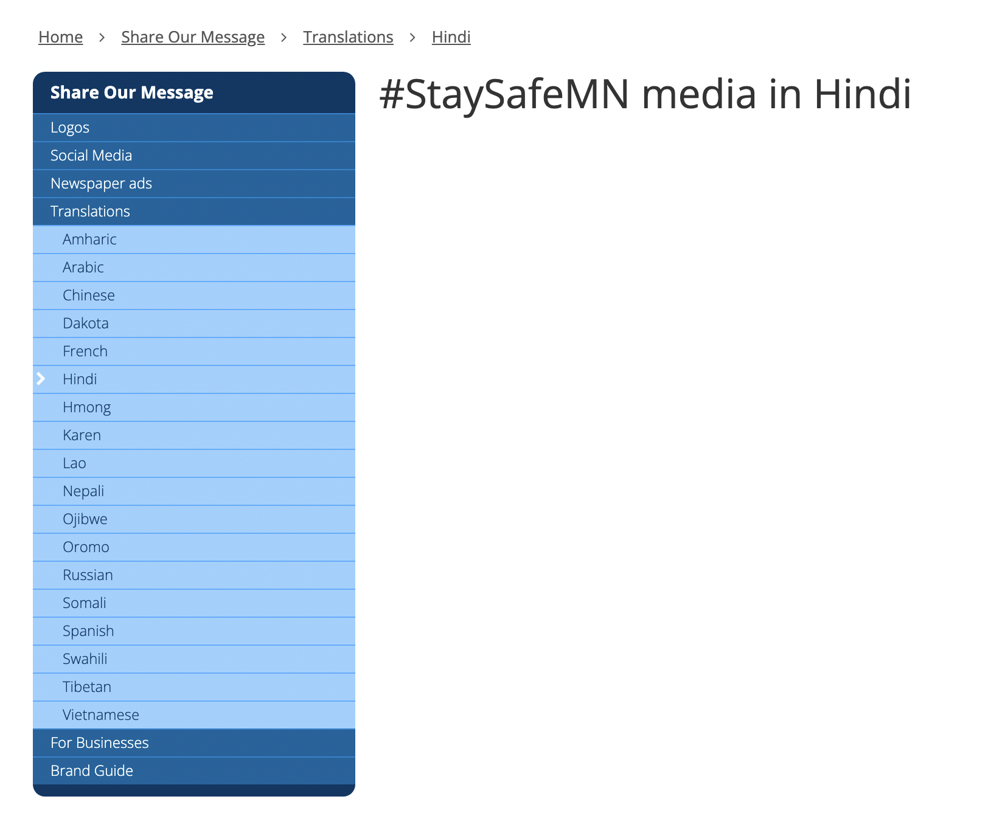
NOT DO – examples from MDH

Slide 24
Project HEALINGS
Ange Hwang
angehwang@amamedia.org
Jiang Zhu
Jiang.zhu@amamedia.org
www.projecthealings.info

Slide 25
