Slide 1
Diversity Council in partnership with
COVID-19 Vaccination Storytelling Project

Slide 2
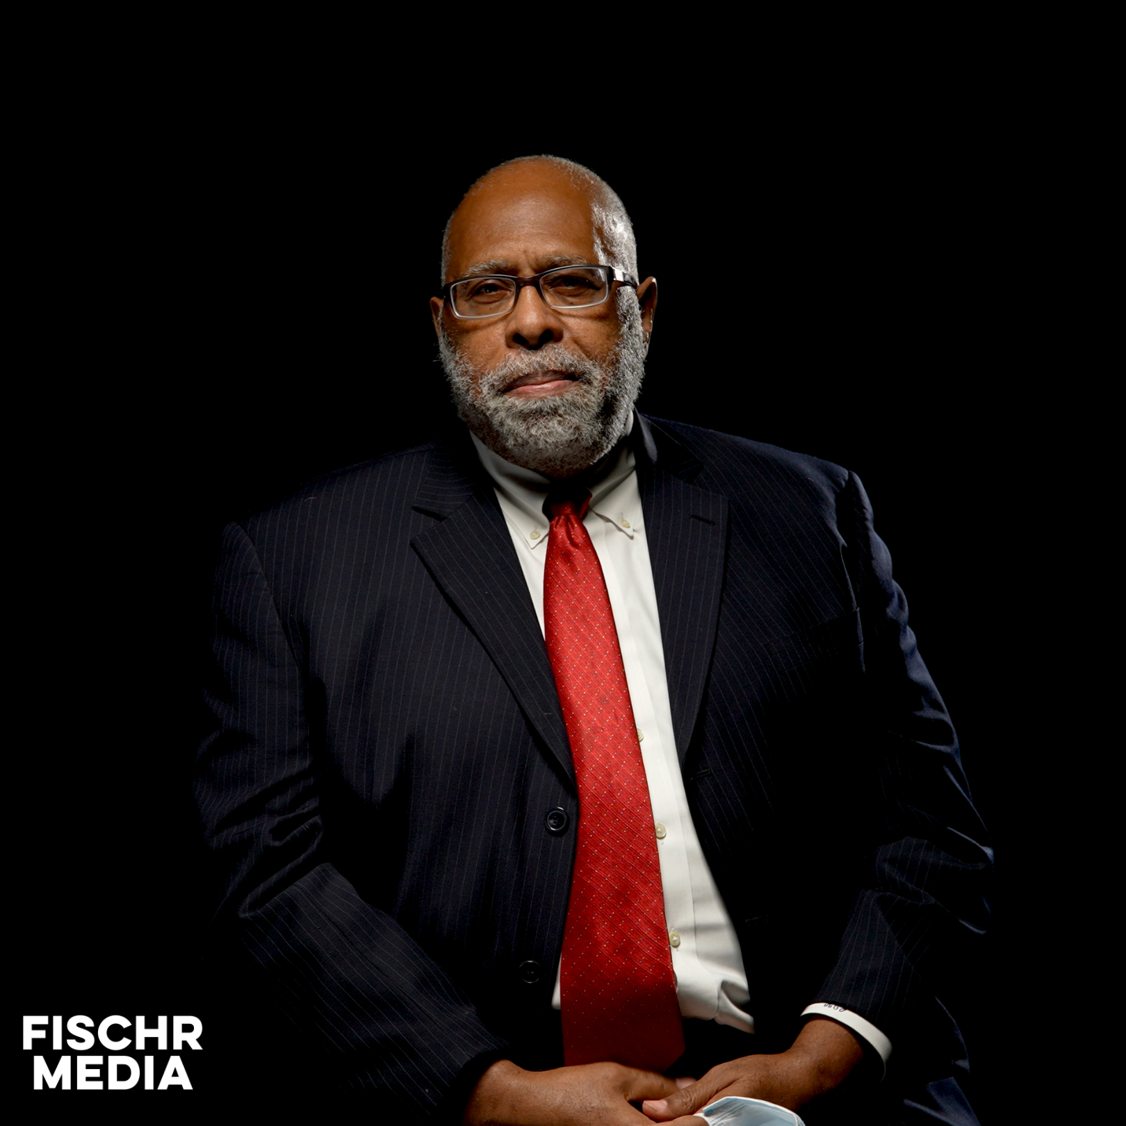
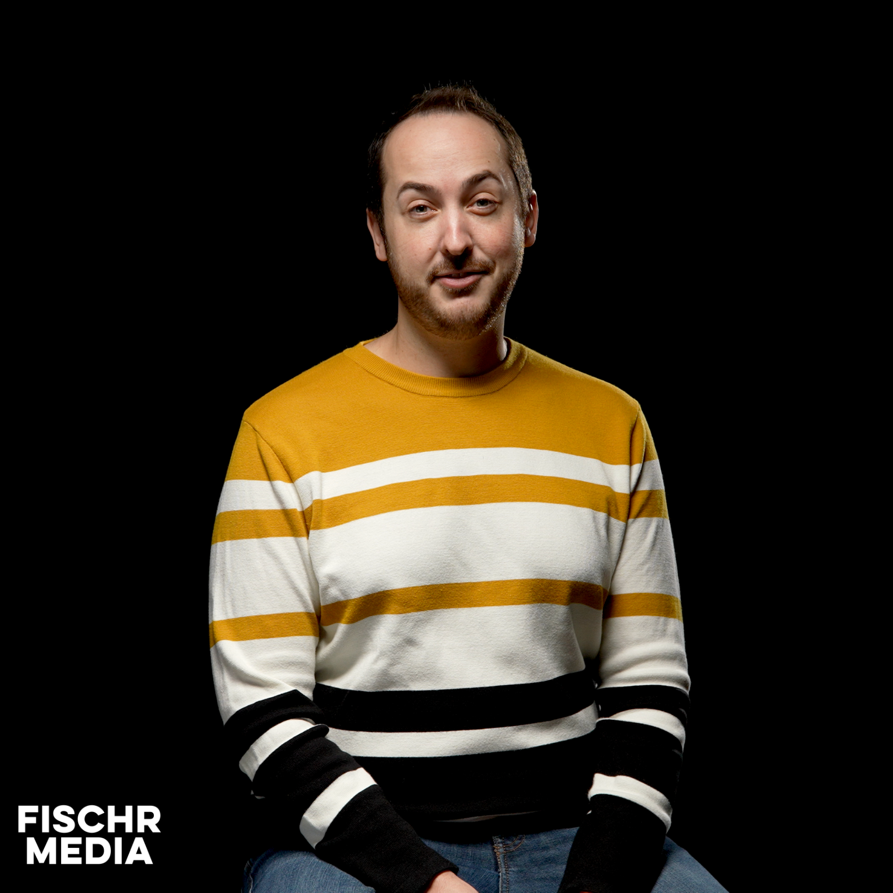
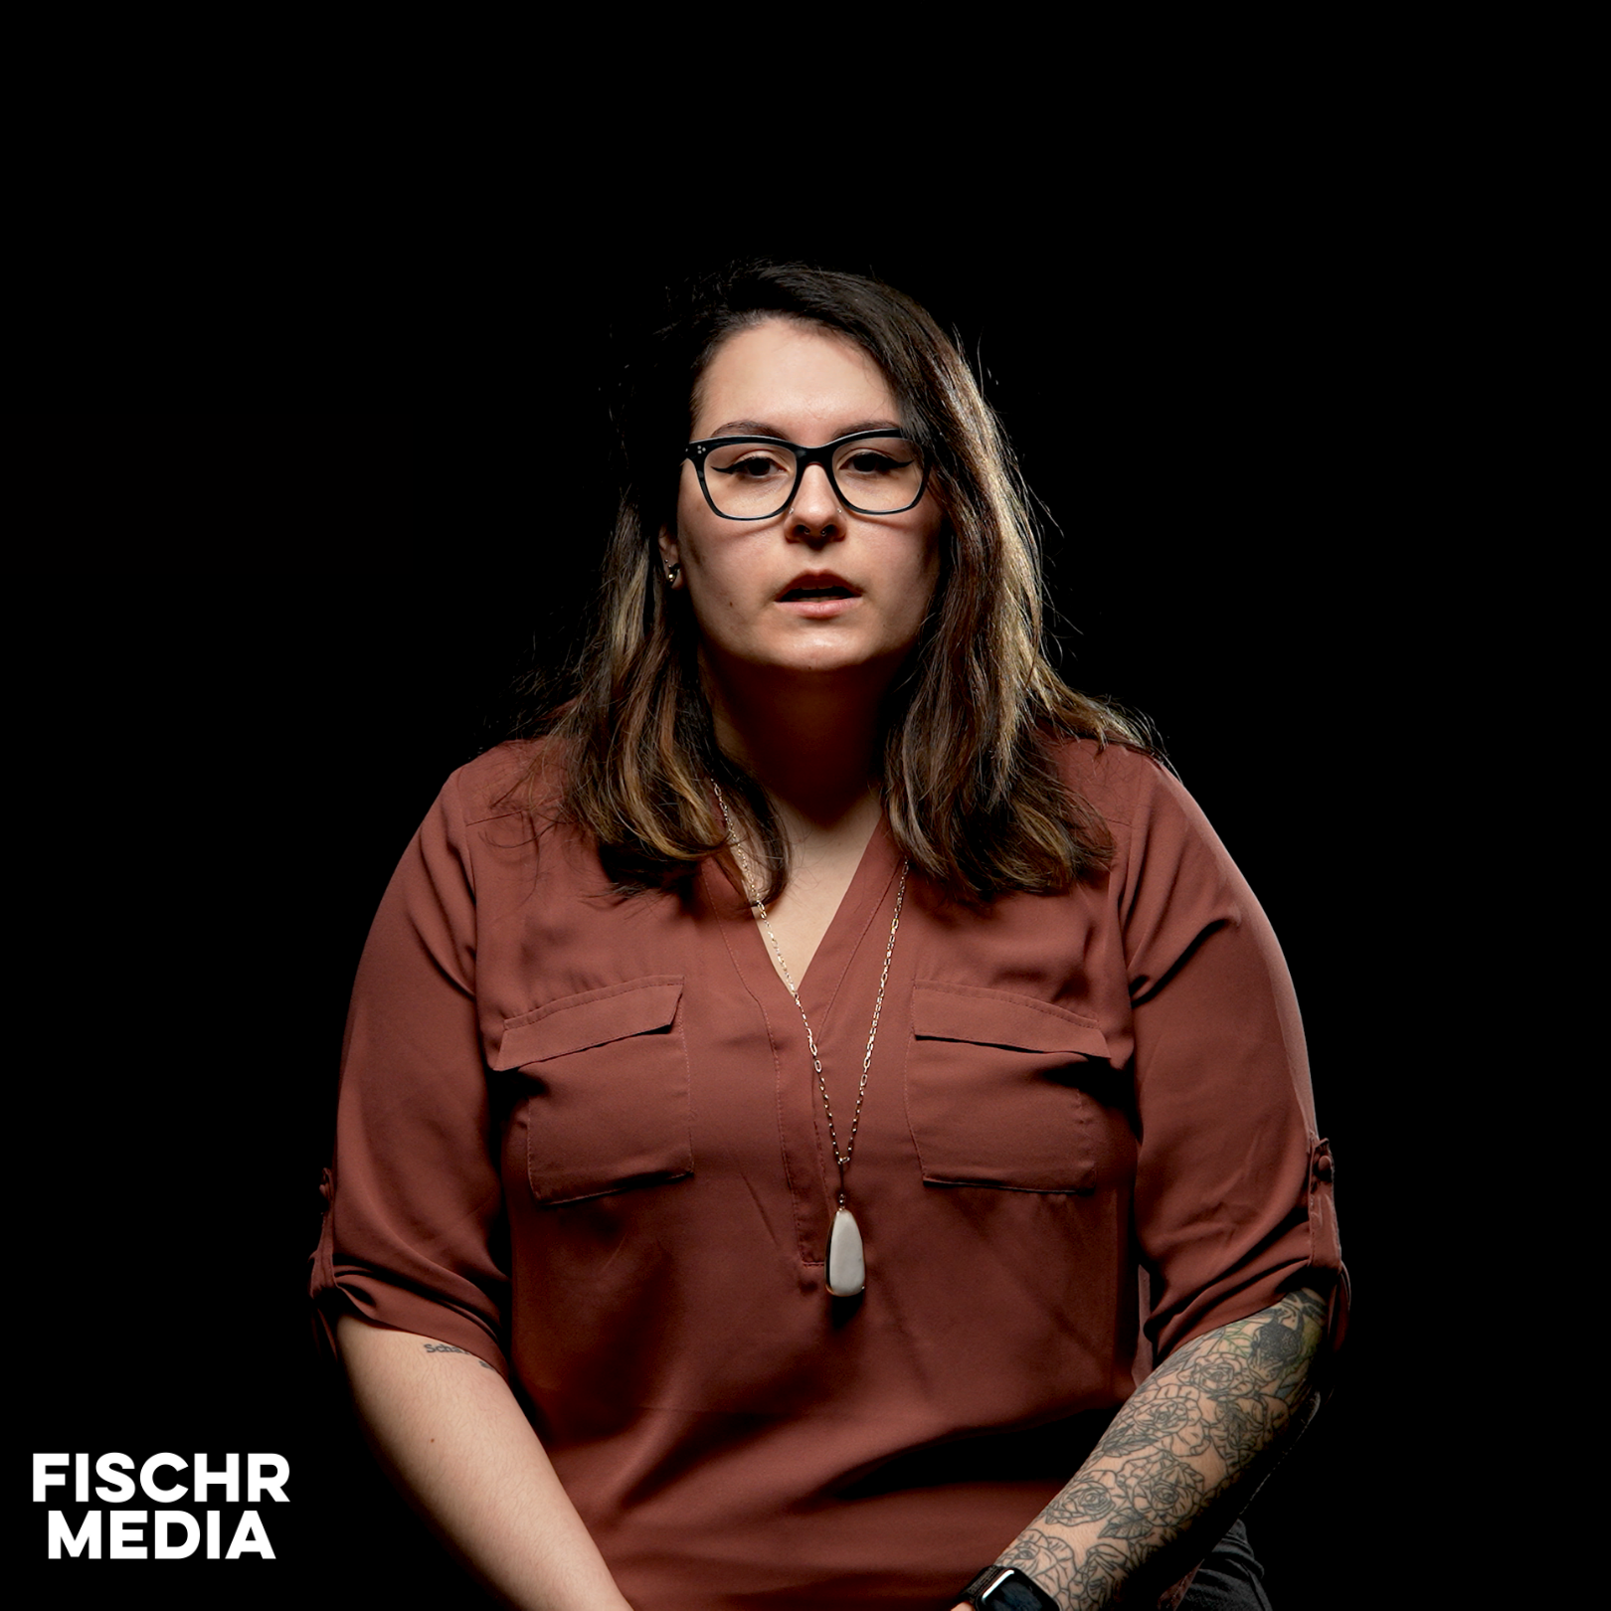
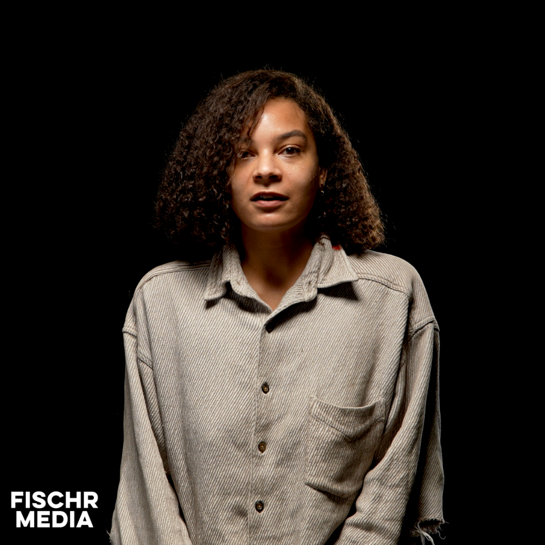
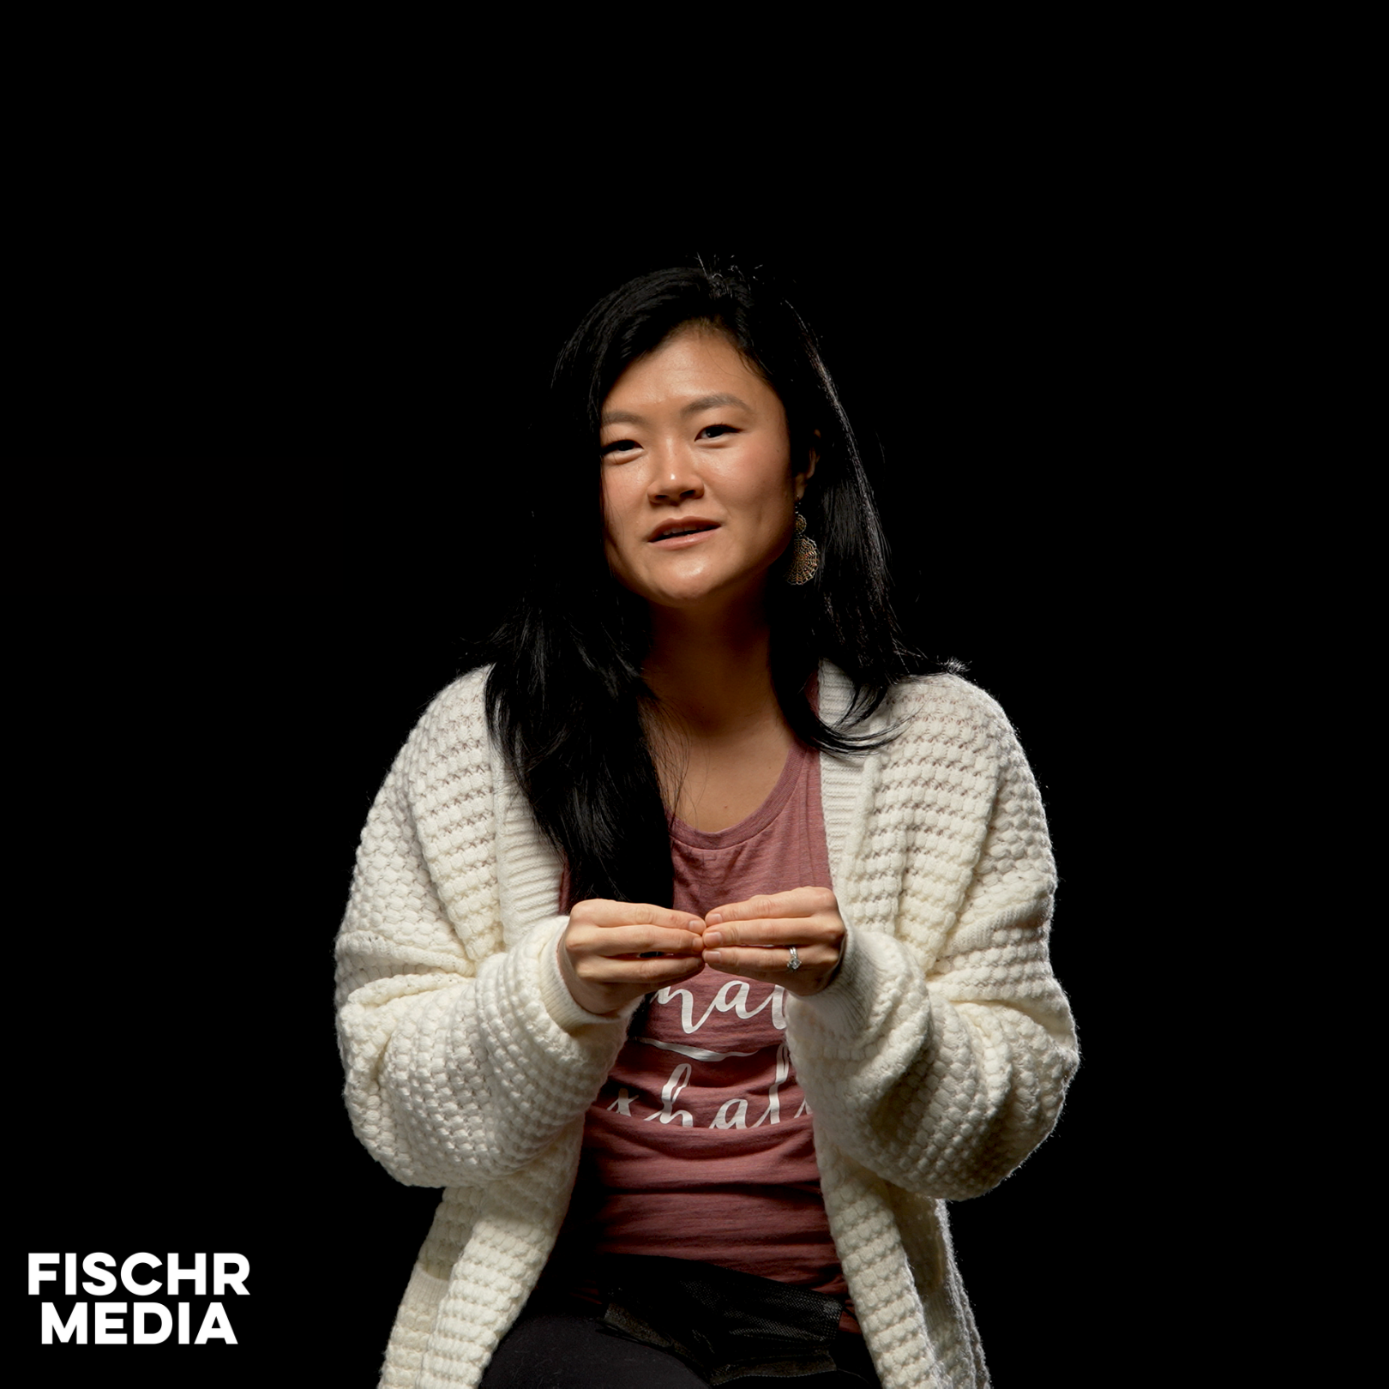
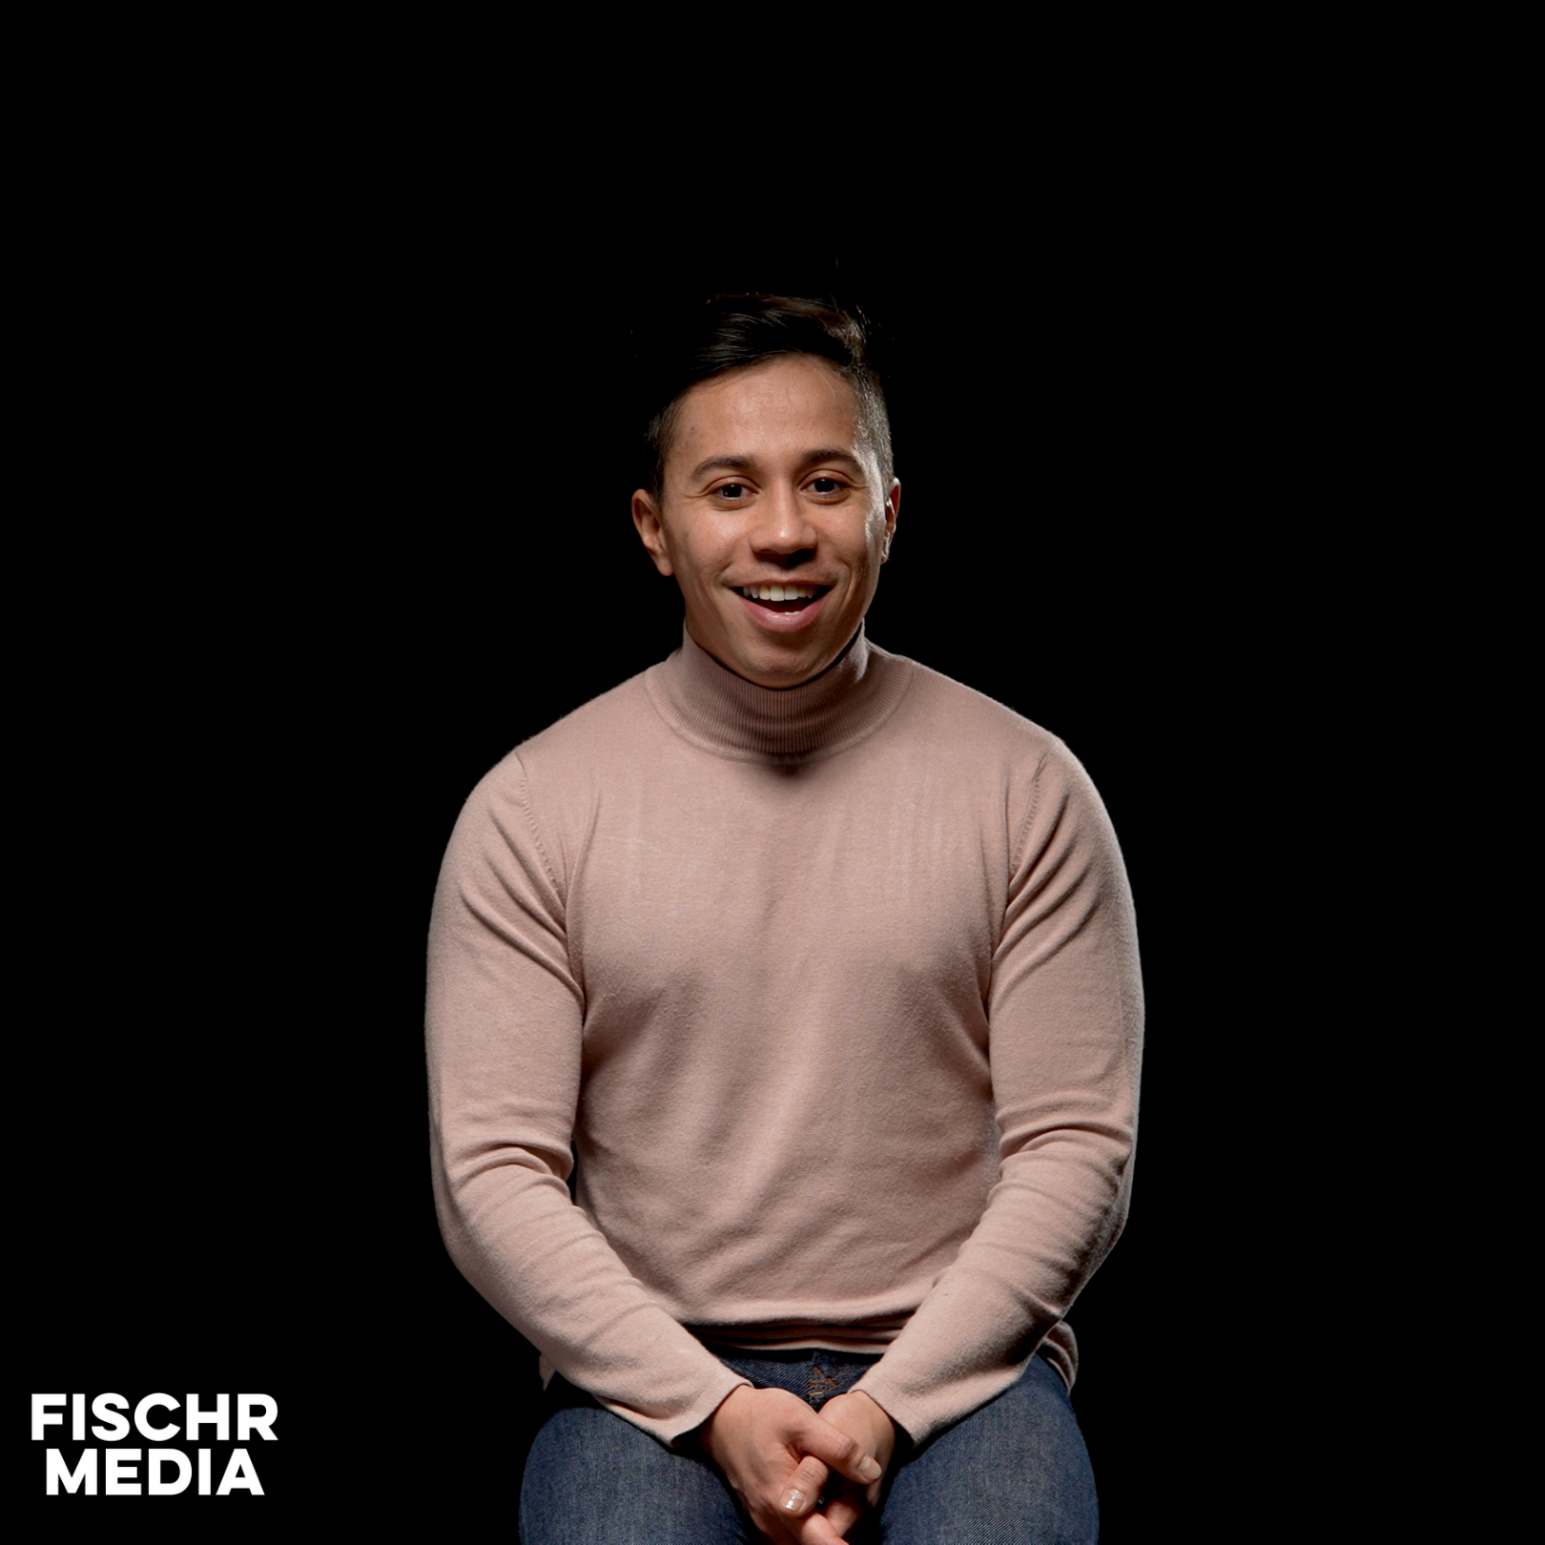
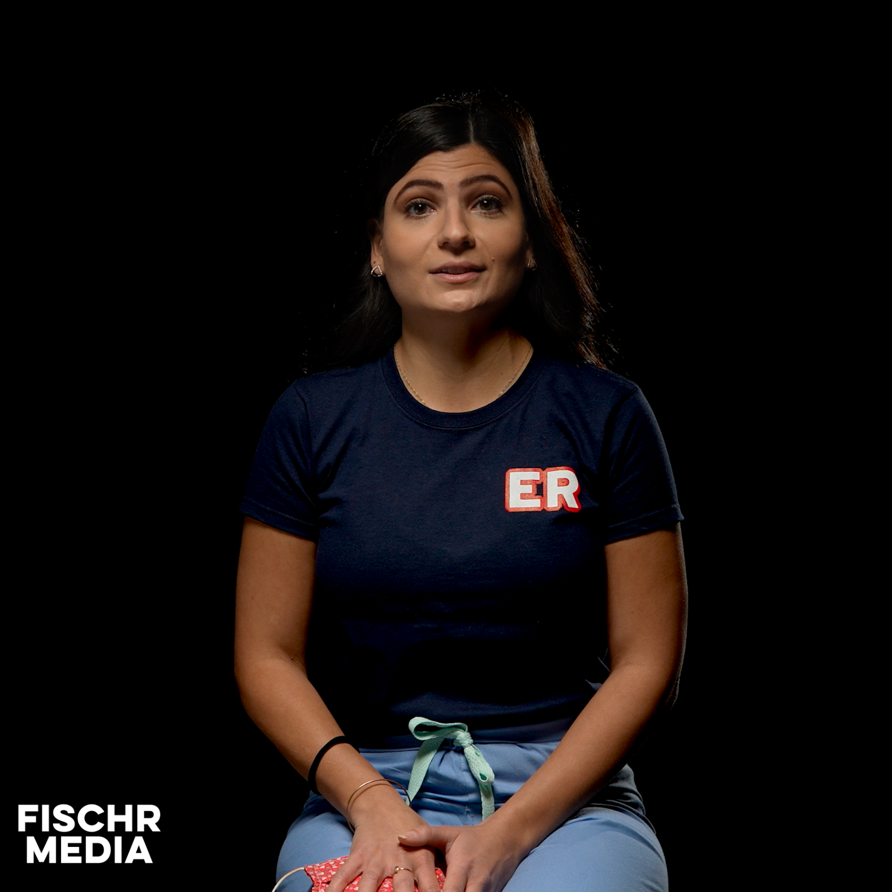
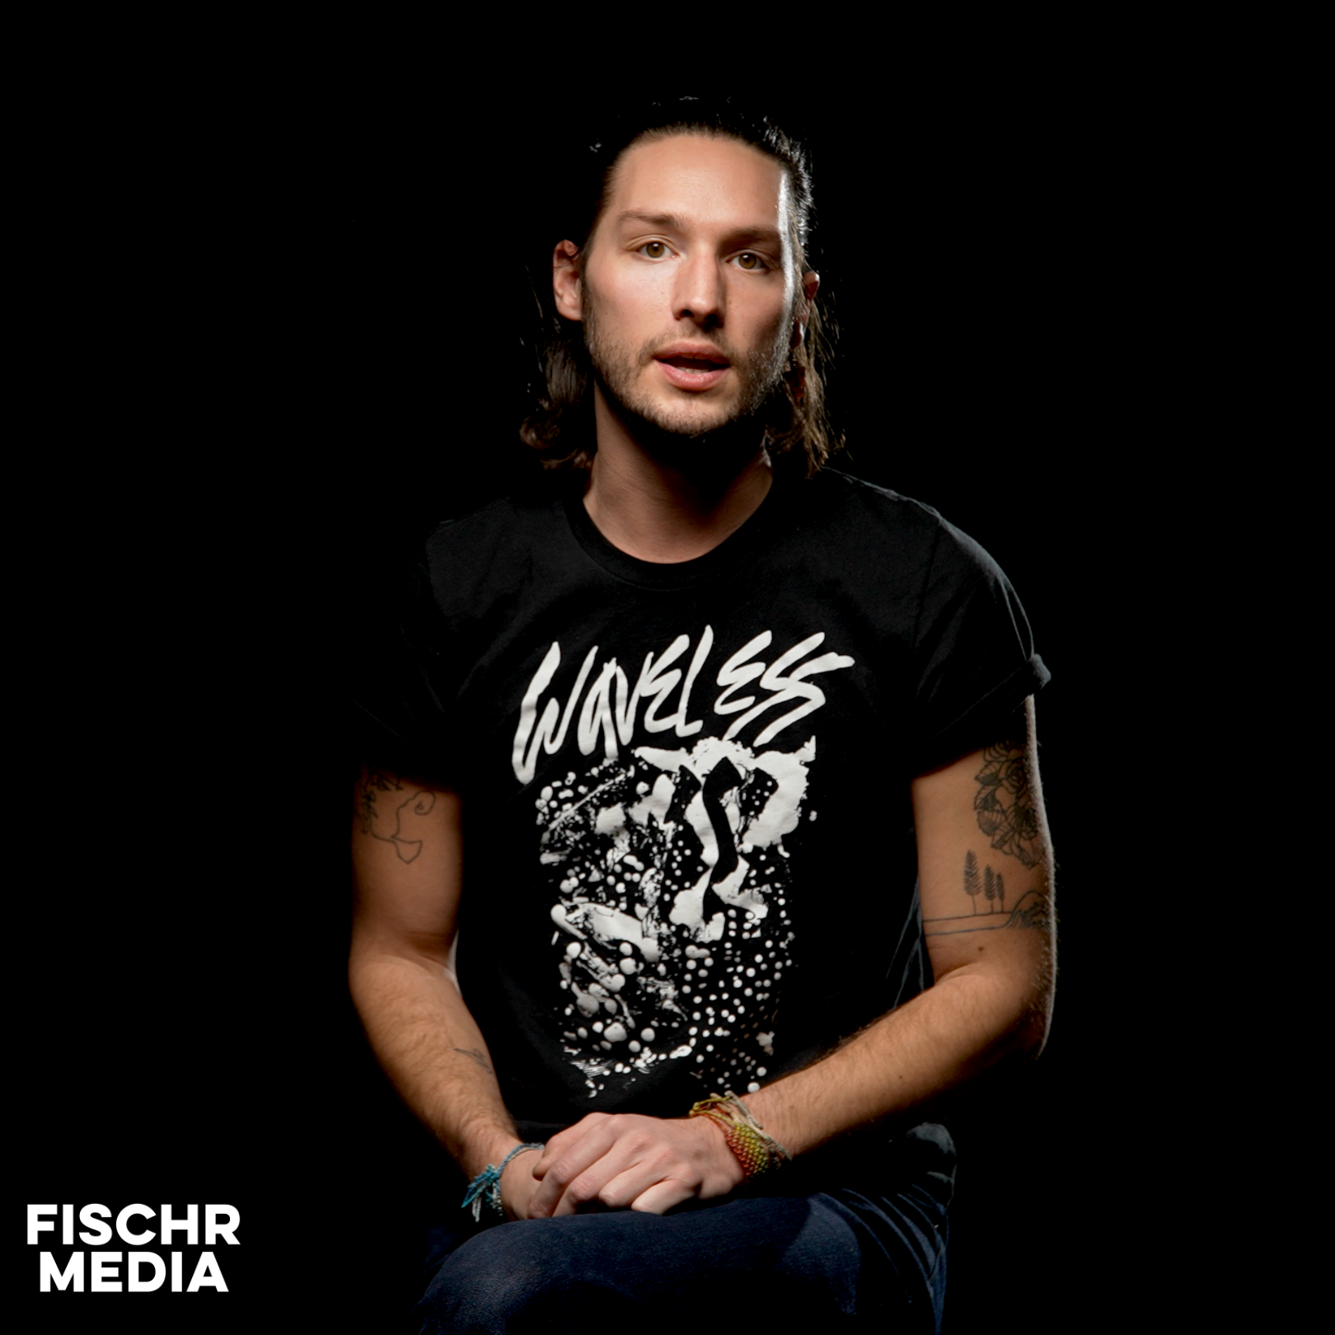
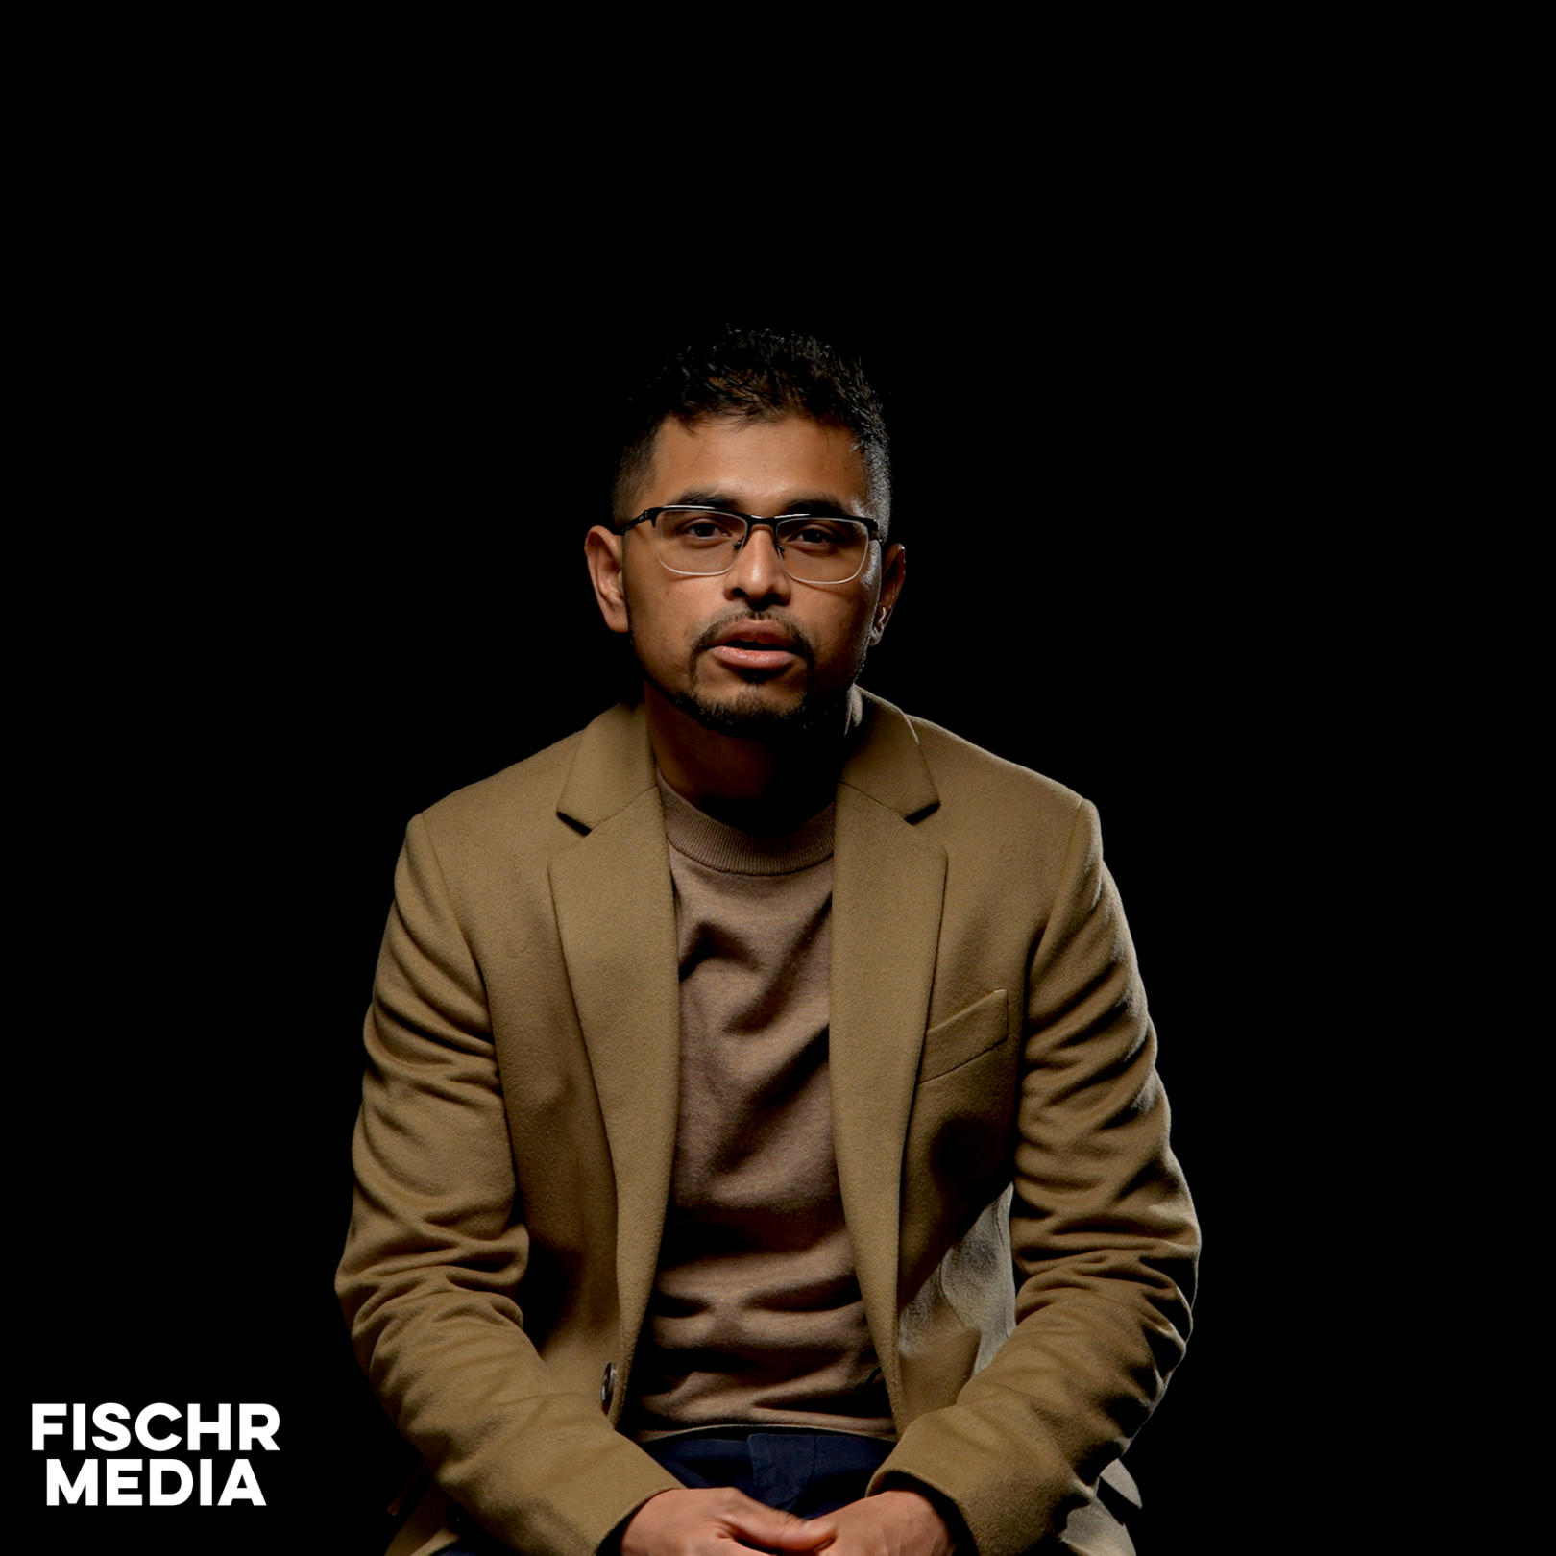
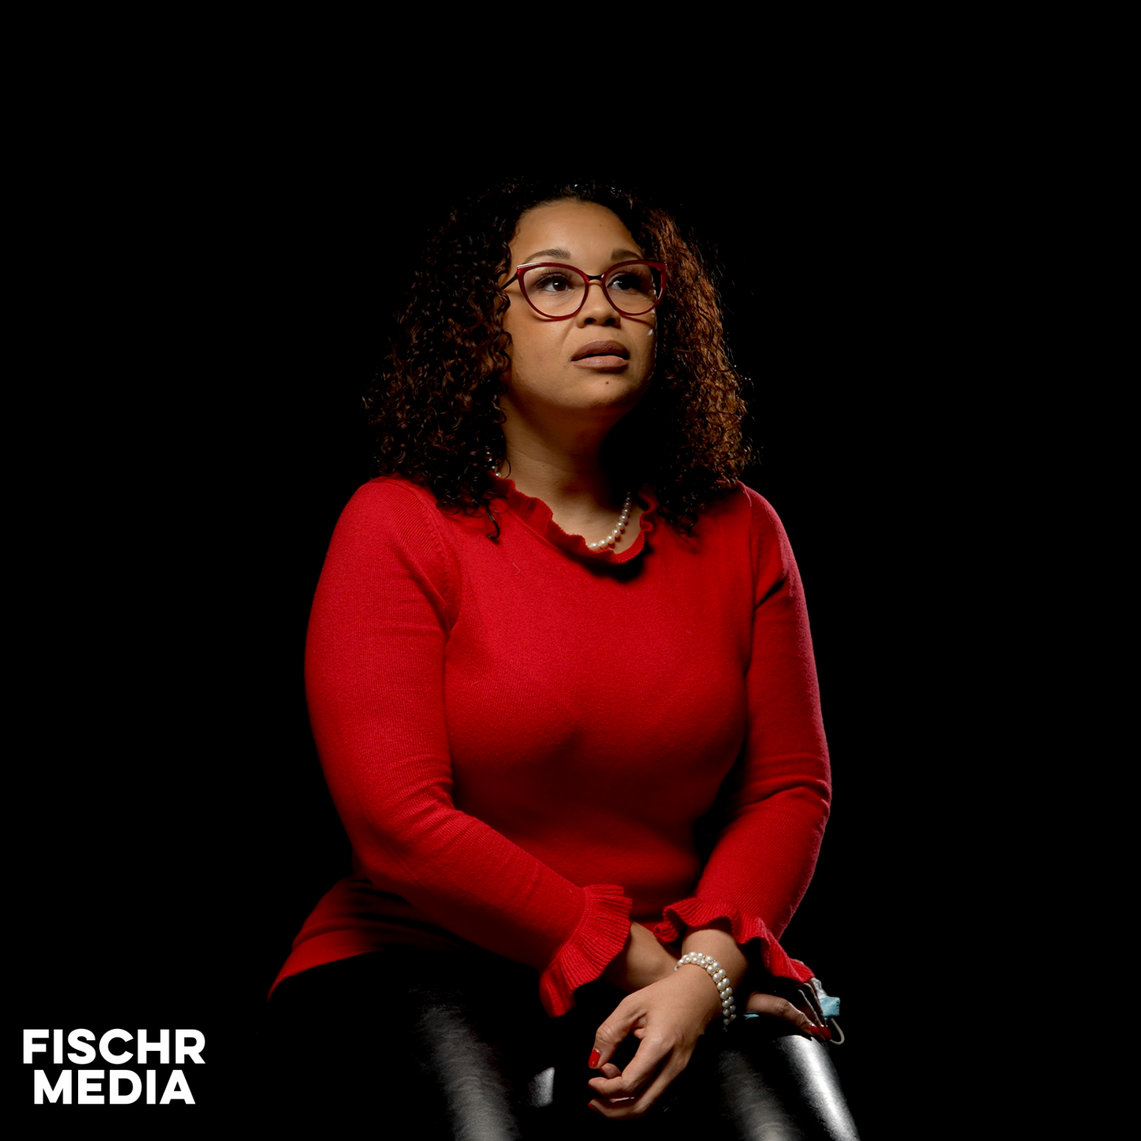
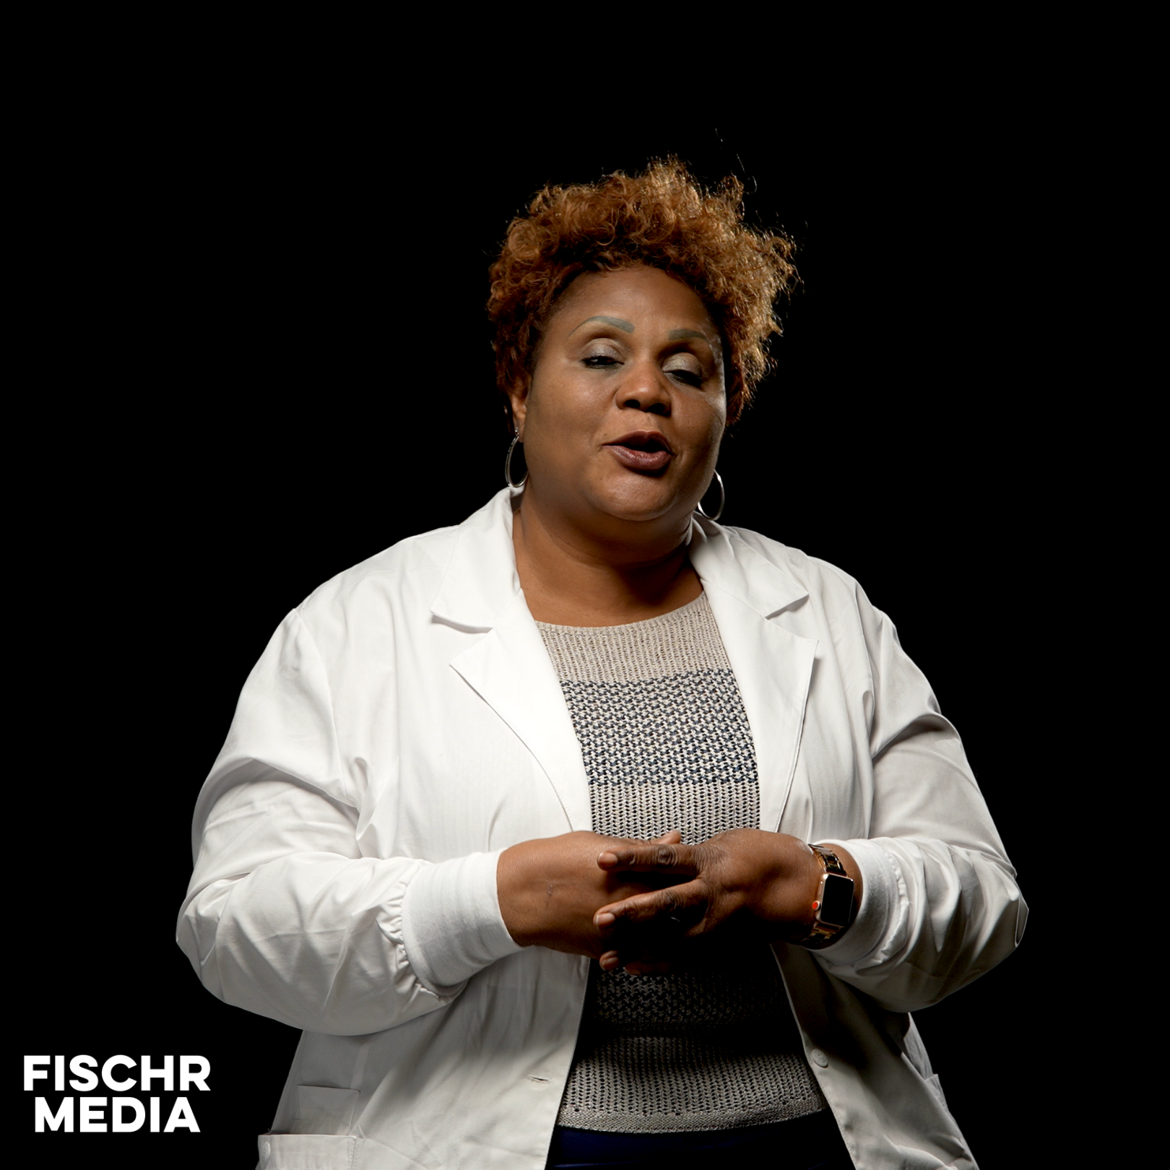
Project Overview:
Film testimonies from 30 community leaders
Combination of native languages and English
Promote vaccine importance through stories

Slide 3
Main Questions For Interview:
How has COVID-19 impacted you personally?
How have you used courage through the pandemic?
Why is community important during events like this?
Why is it important to get vaccinated?

Slide 4
Project Timeline:
Film community leaders during December
Editing throughout January + February
Release finished testimony clips in late Winter

Slide 5
Filming In-Studio:
Recording at Fischr Media’s Production Studio
Located near Downtown Minneapolis (by 394)
Covid Safety Protocol in place in-studio

Slide 6
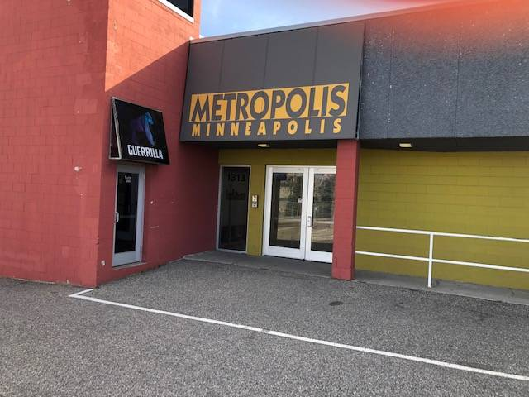
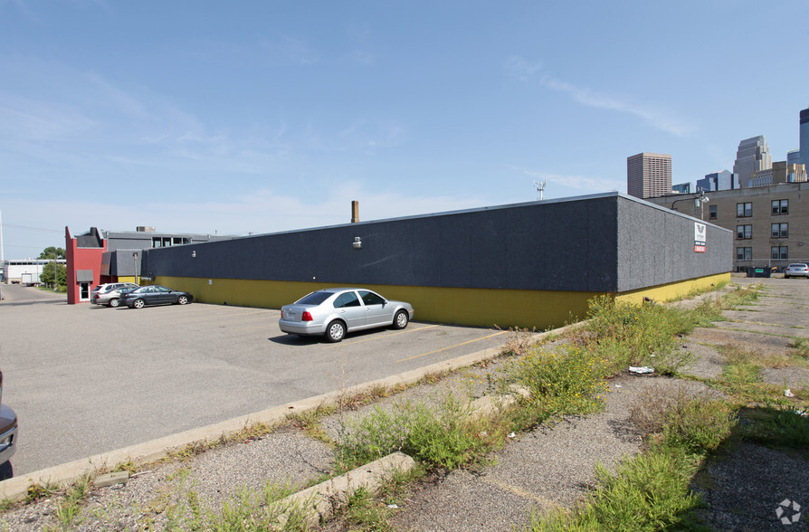
Studio: 1313 Chestnut Avenue Minneapolis, MN 55403

Slide 7
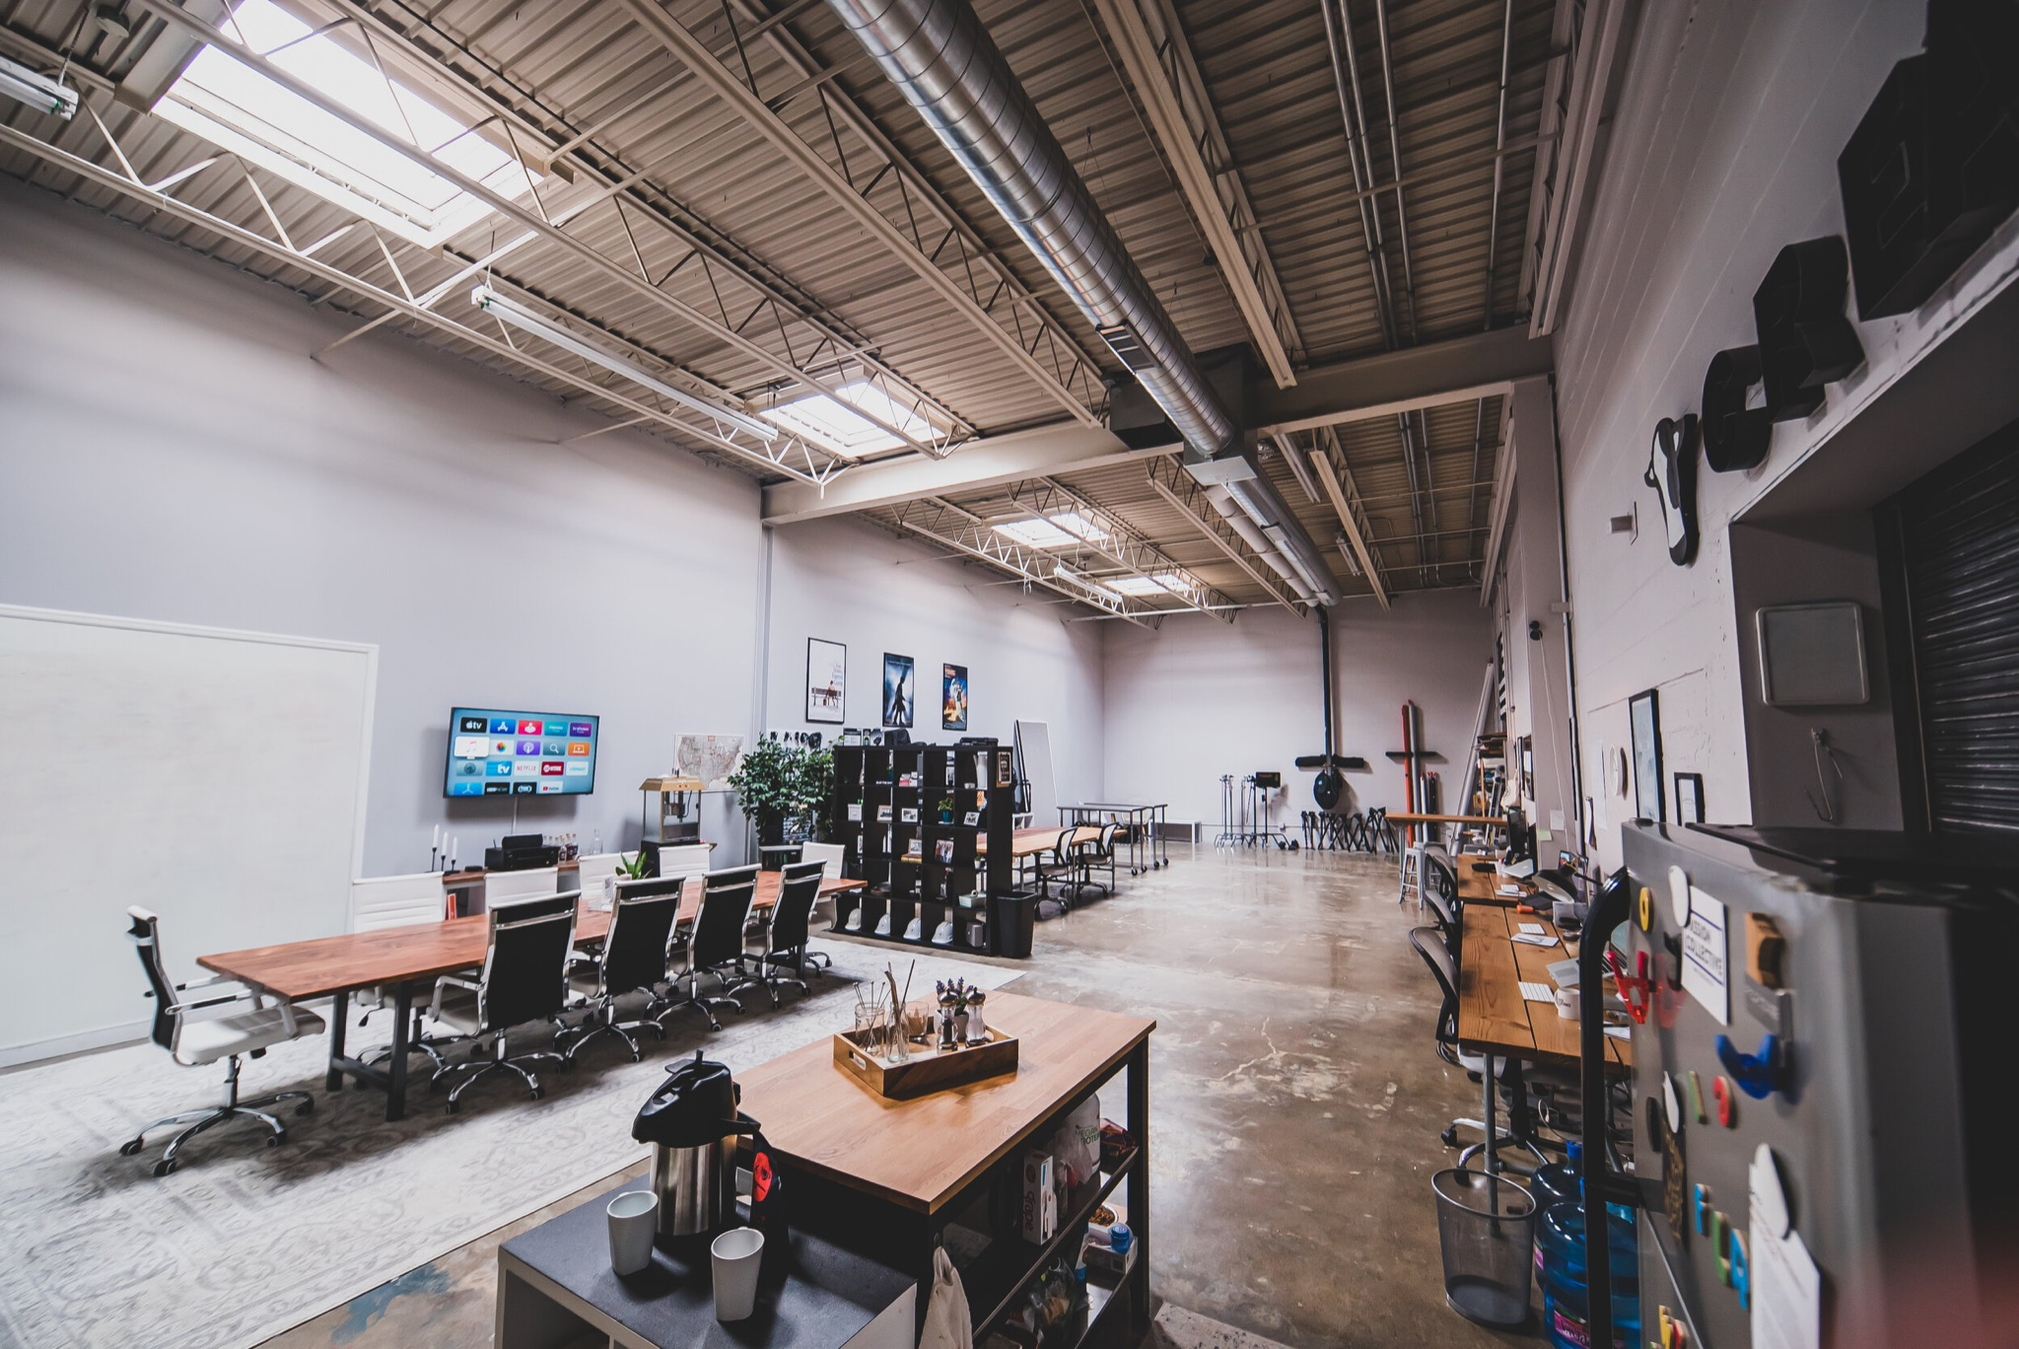
Studio: 1313 Chestnut Avenue Minneapolis, MN 55403

